Slide 1
Sydrome extraction “off-the-hook”
Gilad Kishony and Austin Fowler

Slide 2
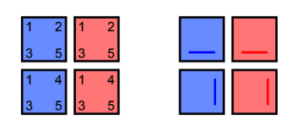
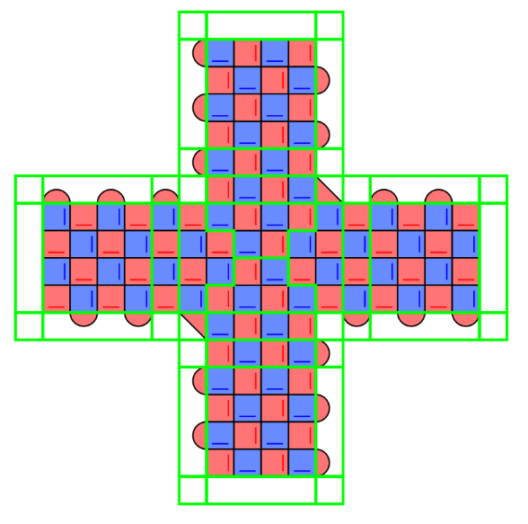

Slide 3
1
4
6
4
1
4
6
4
1
4
3
2
3
5
3
2
3
5
3
2
6
4
1
4
6
4
1
4
6
4
3
5
3
2
3
5
3
2
3
5
1
4
6
4
1
4
6
4
1
4
3
2
3
5
3
2
3
5
3
2
6
4
1
4
6
4
1
4
6
4
3
5
3
2
3
5
3
2
3
5
1
4
6
4
1
4
6
4
1
4
3
2
3
5
3
2
3
5
3
2

Slide 4
Standard schedule
Diagonal schedule

Slide 5
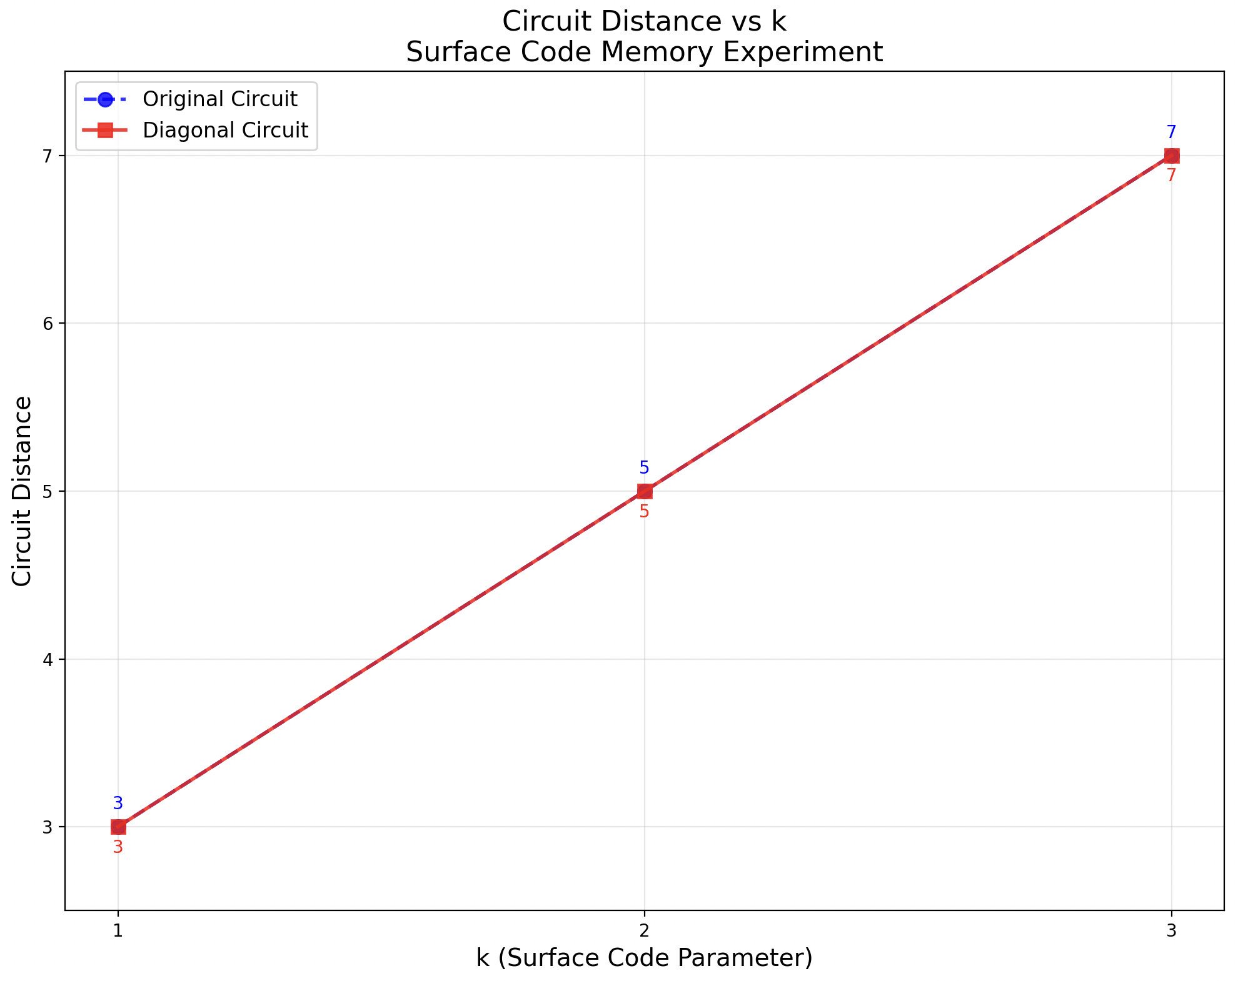
Standard schedule
Diagonal schedule
Default circuit Diagonal circuit

Slide 6
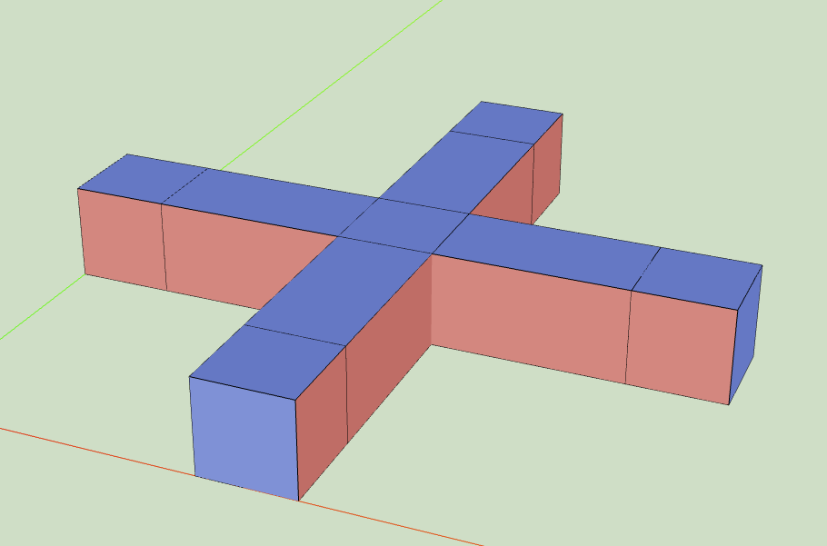
See Crumble circuits in notes
Here the standard schedule needs period 5.
Standard schedule
Diagonal schedule
Notes:
https://algassert.com/crumble#circuit=Q(0,12)0;Q(1,9)1;Q(1,11)2;Q(1,13)3;Q(2,8)4;Q(2,10)5;Q(2,12)6;Q(3,9)7;Q(3,11)8;Q(3,13)9;Q(4,10)10;Q(4,12)11;Q(4,14)12;Q(5,9)13;Q(5,11)14;Q(5,13)15;Q(6,8)16;Q(6,10)17;Q(6,12)18;Q(7,9)19;Q(7,11)20;Q(7,13)21;Q(8,2)22;Q(8,6)23;Q(8,10)24;Q(8,12)25;Q(8,14)26;Q(8,18)27;Q(9,1)28;Q(9,3)29;Q(9,5)30;Q(9,7)31;Q(9,9)32;Q(9,11)33;Q(9,13)34;Q(9,15)35;Q(9,17)36;Q(9,19)37;Q(9,21)38;Q(10,2)39;Q(10,4)40;Q(10,6)41;Q(10,8)42;Q(10,10)43;Q(10,12)44;Q(10,14)45;Q(10,16)46;Q(10,18)47;Q(10,20)48;Q(10,22)49;Q(11,1)50;Q(11,3)51;Q(11,5)52;Q(11,7)53;Q(11,9)54;Q(11,11)55;Q(11,13)56;Q(11,15)57;Q(11,17)58;Q(11,19)59;Q(11,21)60;Q(12,0)61;Q(12,2)62;Q(12,4)63;Q(12,6)64;Q(12,8)65;Q(12,10)66;Q(12,12)67;Q(12,14)68;Q(12,16)69;Q(12,18)70;Q(12,20)71;Q(13,1)72;Q(13,3)73;Q(13,5)74;Q(13,7)75;Q(13,9)76;Q(13,11)77;Q(13,13)78;Q(13,15)79;Q(13,17)80;Q(13,19)81;Q(13,21)82;Q(14,4)83;Q(14,8)84;Q(14,10)85;Q(14,12)86;Q(14,16)87;Q(14,20)88;Q(15,9)89;Q(15,11)90;Q(15,13)91;Q(16,10)92;Q(16,12)93;Q(16,14)94;Q(17,9)95;Q(17,11)96;Q(17,13)97;Q(18,8)98;Q(18,10)99;Q(18,12)100;Q(19,9)101;Q(19,11)102;Q(19,13)103;Q(20,10)104;Q(20,12)105;Q(20,14)106;Q(21,9)107;Q(21,11)108;Q(21,13)109;Q(22,10)110;R_1_2_3_7_8_9_13_14_15_19_20_21_28_29_30_31_32_33_34_35_36_37_38_50_51_52_53_54_55_56_57_58_59_60_72_73_74_75_76_77_78_79_80_81_82_89_90_91_95_96_97_101_102_103_107_108_109;RX_0_4_5_6_10_11_12_16_17_18_22_23_24_25_26_27_39_40_41_42_43_44_45_46_47_48_49_61_62_63_64_65_66_67_68_69_70_71_83_84_85_86_87_88_92_93_94_98_99_100_104_105_106_110;TICK;CX_6_2_10_7_12_9_18_14_24_19_26_21_40_29_42_31_44_33_46_35_48_37_62_50_64_52_66_54_68_56_70_58_83_73_84_75_86_77_87_79_88_81_92_89_94_91_100_96_104_101_106_103;CZ_5_1_11_8_17_13_25_20_39_28_41_30_43_32_45_34_47_36_49_38_63_51_65_53_67_55_69_57_71_59_85_76_93_90_99_95_105_102_110_107;TICK;CX_6_8_10_13_12_15_18_20_22_28_23_30_24_32_26_34_27_36_86_90_92_95_94_97_100_102_104_107_106_109;CZ_0_2_39_50_41_52_43_54_45_56_47_58_49_60_63_73_65_75_67_77_69_79_71_81;TICK;CX_4_1_6_3_10_8_16_13_18_15_24_20_40_30_42_32_44_34_46_36_48_38_62_51_64_53_66_55_68_57_70_59_83_74_84_76_86_78_87_80_88_82_92_90_98_95_100_97_104_102;CZ_5_2_11_9_17_14_25_21_39_29_41_31_43_33_45_35_47_37_61_50_63_52_65_54_67_56_69_58_71_60_85_77_93_91_99_96_105_103_110_108;TICK;CX_40_51_42_53_44_55_46_57_48_59_62_72_64_74_66_76_68_78_70_80;CZ_5_7_11_14_17_19_25_33_85_89_93_96_99_101_105_108;TICK;CX_4_7_6_9_10_14_16_19_18_21_22_29_23_31_24_33_26_35_27_37_40_52_42_54_44_56_46_58_48_60_62_73_64_75_66_77_68_79_70_81_84_89_86_91_92_96_98_101_100_103_104_108;CZ_0_3_5_8_11_15_17_20_25_34_39_51_41_53_43_55_45_57_47_59_61_72_63_74_65_76_67_78_69_80_71_82_85_90_93_97_99_102_105_109;TICK;TICK;MX_0_4_5_6_10_11_12_16_17_18_22_23_24_25_26_27_39_40_41_42_43_44_45_46_47_48_49_61_62_63_64_65_66_67_68_69_70_71_83_84_85_86_87_88_92_93_94_98_99_100_104_105_106_110;DT(0,12,0)rec[-54];DT(2,10,0)rec[-52];DT(4,12,0)rec[-49];DT(6,10,0)rec[-46];DT(8,12,0)rec[-41];DT(10,2,0)rec[-38];DT(10,6,0)rec[-36];DT(10,10,0)rec[-34];DT(10,14,0)rec[-32];DT(10,18,0)rec[-30];DT(10,22,0)rec[-28];DT(12,0,0)rec[-27];DT(12,4,0)rec[-25];DT(12,8,0)rec[-23];DT(12,12,0)rec[-21];DT(12,16,0)rec[-19];DT(12,20,0)rec[-17];DT(14,10,0)rec[-14];DT(16,12,0)rec[-9];DT(18,10,0)rec[-6];DT(20,12,0)rec[-3];DT(22,10,0)rec[-1];TICK;RX_0_4_5_6_10_11_12_16_17_18_22_23_24_25_26_27_39_40_41_42_43_44_45_46_47_48_49_61_62_63_64_65_66_67_68_69_70_71_83_84_85_86_87_88_92_93_94_98_99_100_104_105_106_110;TICK;CX_6_2_10_7_12_9_18_14_24_19_26_21_40_29_42_31_44_33_46_35_48_37_62_50_64_52_66_54_68_56_70_58_83_73_84_75_86_77_87_79_88_81_92_89_94_91_100_96_104_101_106_103;CZ_5_1_11_8_17_13_25_20_39_28_41_30_43_32_45_34_47_36_49_38_63_51_65_53_67_55_69_57_71_59_85_76_93_90_99_95_105_102_110_107;TICK;CX_6_8_10_13_12_15_18_20_22_28_23_30_24_32_26_34_27_36_86_90_92_95_94_97_100_102_104_107_106_109;CZ_0_2_39_50_41_52_43_54_45_56_47_58_49_60_63_73_65_75_67_77_69_79_71_81;TICK;CX_4_1_6_3_10_8_16_13_18_15_24_20_40_30_42_32_44_34_46_36_48_38_62_51_64_53_66_55_68_57_70_59_83_74_84_76_86_78_87_80_88_82_92_90_98_95_100_97_104_102;CZ_5_2_11_9_17_14_25_21_39_29_41_31_43_33_45_35_47_37_61_50_63_52_65_54_67_56_69_58_71_60_85_77_93_91_99_96_105_103_110_108;TICK;CX_40_51_42_53_44_55_46_57_48_59_62_72_64_74_66_76_68_78_70_80;CZ_5_7_11_14_17_19_25_33_85_89_93_96_99_101_105_108;TICK;CX_4_7_6_9_10_14_16_19_18_21_22_29_23_31_24_33_26_35_27_37_40_52_42_54_44_56_46_58_48_60_62_73_64_75_66_77_68_79_70_81_84_89_86_91_92_96_98_101_100_103_104_108;CZ_0_3_5_8_11_15_17_20_25_34_39_51_41_53_43_55_45_57_47_59_61_72_63_74_65_76_67_78_69_80_71_82_85_90_93_97_99_102_105_109;TICK;TICK;MX_0_4_5_6_10_11_12_16_17_18_22_23_24_25_26_27_39_40_41_42_43_44_45_46_47_48_49_61_62_63_64_65_66_67_68_69_70_71_83_84_85_86_87_88_92_93_94_98_99_100_104_105_106_110;DT(0,12,1)rec[-54]_rec[-108];DT(2,8,1)rec[-53]_rec[-107];DT(2,10,1)rec[-52]_rec[-106];DT(2,12,1)rec[-51]_rec[-105];DT(4,10,1)rec[-50]_rec[-104];DT(4,12,1)rec[-49]_rec[-103];DT(4,14,1)rec[-48]_rec[-102];DT(6,8,1)rec[-47]_rec[-101];DT(6,10,1)rec[-46]_rec[-100];DT(6,12,1)rec[-45]_rec[-99];DT(8,2,1)rec[-44]_rec[-98];DT(8,6,1)rec[-43]_rec[-97];DT(8,10,1)rec[-42]_rec[-96];DT(8,12,1)rec[-41]_rec[-95];DT(8,14,1)rec[-40]_rec[-94];DT(8,18,1)rec[-39]_rec[-93];DT(10,2,1)rec[-38]_rec[-92];DT(10,4,1)rec[-37]_rec[-91];DT(10,6,1)rec[-36]_rec[-90];DT(10,8,1)rec[-35]_rec[-89];DT(10,10,1)rec[-34]_rec[-88];DT(10,12,1)rec[-33]_rec[-87];DT(10,14,1)rec[-32]_rec[-86];DT(10,16,1)rec[-31]_rec[-85];DT(10,18,1)rec[-30]_rec[-84];DT(10,20,1)rec[-29]_rec[-83];DT(10,22,1)rec[-28]_rec[-82];DT(12,0,1)rec[-27]_rec[-81];DT(12,2,1)rec[-26]_rec[-80];DT(12,4,1)rec[-25]_rec[-79];DT(12,6,1)rec[-24]_rec[-78];DT(12,8,1)rec[-23]_rec[-77];DT(12,10,1)rec[-22]_rec[-76];DT(12,12,1)rec[-21]_rec[-75];DT(12,14,1)rec[-20]_rec[-74];DT(12,16,1)rec[-19]_rec[-73];DT(12,18,1)rec[-18]_rec[-72];DT(12,20,1)rec[-17]_rec[-71];DT(14,4,1)rec[-16]_rec[-70];DT(14,8,1)rec[-15]_rec[-69];DT(14,10,1)rec[-14]_rec[-68];DT(14,12,1)rec[-13]_rec[-67];DT(14,16,1)rec[-12]_rec[-66];DT(14,20,1)rec[-11]_rec[-65];DT(16,10,1)rec[-10]_rec[-64];DT(16,12,1)rec[-9]_rec[-63];DT(16,14,1)rec[-8]_rec[-62];DT(18,8,1)rec[-7]_rec[-61];DT(18,10,1)rec[-6]_rec[-60];DT(18,12,1)rec[-5]_rec[-59];DT(20,10,1)rec[-4]_rec[-58];DT(20,12,1)rec[-3]_rec[-57];DT(20,14,1)rec[-2]_rec[-56];DT(22,10,1)rec[-1]_rec[-55];TICK;RX_0_4_5_6_10_11_12_16_17_18_22_23_24_25_26_27_39_40_41_42_43_44_45_46_47_48_49_61_62_63_64_65_66_67_68_69_70_71_83_84_85_86_87_88_92_93_94_98_99_100_104_105_106_110;TICK;CX_6_2_10_7_12_9_18_14_24_19_26_21_40_29_42_31_44_33_46_35_48_37_62_50_64_52_66_54_68_56_70_58_83_73_84_75_86_77_87_79_88_81_92_89_94_91_100_96_104_101_106_103;CZ_5_1_11_8_17_13_25_20_39_28_41_30_43_32_45_34_47_36_49_38_63_51_65_53_67_55_69_57_71_59_85_76_93_90_99_95_105_102_110_107;TICK;CX_6_8_10_13_12_15_18_20_22_28_23_30_24_32_26_34_27_36_86_90_92_95_94_97_100_102_104_107_106_109;CZ_0_2_39_50_41_52_43_54_45_56_47_58_49_60_63_73_65_75_67_77_69_79_71_81;TICK;CX_4_1_6_3_10_8_16_13_18_15_24_20_40_30_42_32_44_34_46_36_48_38_62_51_64_53_66_55_68_57_70_59_83_74_84_76_86_78_87_80_88_82_92_90_98_95_100_97_104_102;CZ_5_2_11_9_17_14_25_21_39_29_41_31_43_33_45_35_47_37_61_50_63_52_65_54_67_56_69_58_71_60_85_77_93_91_99_96_105_103_110_108;TICK;CX_40_51_42_53_44_55_46_57_48_59_62_72_64_74_66_76_68_78_70_80;CZ_5_7_11_14_17_19_25_33_85_89_93_96_99_101_105_108;TICK;CX_4_7_6_9_10_14_16_19_18_21_22_29_23_31_24_33_26_35_27_37_40_52_42_54_44_56_46_58_48_60_62_73_64_75_66_77_68_79_70_81_84_89_86_91_92_96_98_101_100_103_104_108;CZ_0_3_5_8_11_15_17_20_25_34_39_51_41_53_43_55_45_57_47_59_61_72_63_74_65_76_67_78_69_80_71_82_85_90_93_97_99_102_105_109;TICK;TICK;M_1_2_3_7_8_9_13_14_15_19_20_21_28_29_30_31_32_33_34_35_36_37_38_50_51_52_53_54_55_56_57_58_59_60_72_73_74_75_76_77_78_79_80_81_82_89_90_91_95_96_97_101_102_103_107_108_109;MX_0_4_5_6_10_11_12_16_17_18_22_23_24_25_26_27_39_40_41_42_43_44_45_46_47_48_49_61_62_63_64_65_66_67_68_69_70_71_83_84_85_86_87_88_92_93_94_98_99_100_104_105_106_110;DT(0,12,2)rec[-54]_rec[-109]_rec[-110];DT(0,12,3)rec[-54]_rec[-165];DT(2,8,2)rec[-53]_rec[-164];DT(2,10,2)rec[-52]_rec[-107]_rec[-108]_rec[-110]_rec[-111];DT(2,10,3)rec[-52]_rec[-163];DT(2,12,2)rec[-51]_rec[-162];DT(4,10,2)rec[-50]_rec[-161];DT(4,12,2)rec[-49]_rec[-103]_rec[-104]_rec[-106]_rec[-107];DT(4,12,3)rec[-49]_rec[-160];DT(4,14,2)rec[-48]_rec[-159];DT(6,8,2)rec[-47]_rec[-158];DT(6,10,2)rec[-46]_rec[-101]_rec[-102]_rec[-104]_rec[-105];DT(6,10,3)rec[-46]_rec[-157];DT(6,12,2)rec[-45]_rec[-156];DT(8,2,2)rec[-44]_rec[-155];DT(8,6,2)rec[-43]_rec[-154];DT(8,10,2)rec[-42]_rec[-153];DT(8,12,2)rec[-41]_rec[-93]_rec[-94]_rec[-100]_rec[-101];DT(8,12,3)rec[-41]_rec[-152];DT(8,14,2)rec[-40]_rec[-151];DT(8,18,2)rec[-39]_rec[-150];DT(10,2,2)rec[-38]_rec[-87]_rec[-88]_rec[-98]_rec[-99];DT(10,2,3)rec[-38]_rec[-149];DT(10,4,2)rec[-37]_rec[-148];DT(10,6,2)rec[-36]_rec[-147];DT(11,7,2)rec[-36]_rec[-85]_rec[-86]_rec[-96]_rec[-97];DT(10,8,2)rec[-35]_rec[-146];DT(10,10,2)rec[-34]_rec[-83]_rec[-84]_rec[-94]_rec[-95];DT(10,10,3)rec[-34]_rec[-145];DT(10,12,2)rec[-33]_rec[-144];DT(10,14,2)rec[-32]_rec[-81]_rec[-82]_rec[-92]_rec[-93];DT(10,14,3)rec[-32]_rec[-143];DT(10,16,2)rec[-31]_rec[-142];DT(10,18,2)rec[-30]_rec[-79]_rec[-80]_rec[-90]_rec[-91];DT(10,18,3)rec[-30]_rec[-141];DT(10,20,2)rec[-29]_rec[-140];DT(10,22,2)rec[-28]_rec[-78]_rec[-89];DT(10,22,3)rec[-28]_rec[-139];DT(12,0,2)rec[-27]_rec[-77]_rec[-88];DT(12,0,3)rec[-27]_rec[-138];DT(12,2,2)rec[-26]_rec[-137];DT(12,4,2)rec[-25]_rec[-75]_rec[-76]_rec[-86]_rec[-87];DT(12,4,3)rec[-25]_rec[-136];DT(12,6,2)rec[-24]_rec[-135];DT(12,8,2)rec[-23]_rec[-73]_rec[-74]_rec[-84]_rec[-85];DT(12,8,3)rec[-23]_rec[-134];DT(12,10,2)rec[-22]_rec[-133];DT(12,12,2)rec[-21]_rec[-132];DT(13,13,2)rec[-21]_rec[-71]_rec[-72]_rec[-82]_rec[-83];DT(12,14,2)rec[-20]_rec[-131];DT(12,16,2)rec[-19]_rec[-130];DT(13,17,2)rec[-19]_rec[-69]_rec[-70]_rec[-80]_rec[-81];DT(12,18,2)rec[-18]_rec[-129];DT(12,20,2)rec[-17]_rec[-67]_rec[-68]_rec[-78]_rec[-79];DT(12,20,3)rec[-17]_rec[-128];DT(14,4,2)rec[-16]_rec[-127];DT(14,8,2)rec[-15]_rec[-126];DT(14,10,2)rec[-14]_rec[-65]_rec[-66]_rec[-72]_rec[-73];DT(14,10,3)rec[-14]_rec[-125];DT(14,12,2)rec[-13]_rec[-124];DT(14,16,2)rec[-12]_rec[-123];DT(14,20,2)rec[-11]_rec[-122];DT(16,10,2)rec[-10]_rec[-121];DT(16,12,2)rec[-9]_rec[-120];DT(17,13,2)rec[-9]_rec[-61]_rec[-62]_rec[-64]_rec[-65];DT(16,14,2)rec[-8]_rec[-119];DT(18,8,2)rec[-7]_rec[-118];DT(18,10,2)rec[-6]_rec[-59]_rec[-60]_rec[-62]_rec[-63];DT(18,10,3)rec[-6]_rec[-117];DT(18,12,2)rec[-5]_rec[-116];DT(20,10,2)rec[-4]_rec[-115];DT(20,12,2)rec[-3]_rec[-114];DT(21,13,2)rec[-3]_rec[-55]_rec[-56]_rec[-58]_rec[-59];DT(20,14,2)rec[-2]_rec[-113];DT(22,10,2)rec[-1]_rec[-56]_rec[-57];DT(22,10,3)rec[-1]_rec[-112];OI(0)rec[-56]_rec[-59]_rec[-62]_rec[-65]_rec[-72]_rec[-83]_rec[-94]_rec[-101]_rec[-104]_rec[-107]_rec[-110];OI(1)rec[-56]_rec[-59]_rec[-62]_rec[-65]_rec[-72]_rec[-84]_rec[-85]_rec[-86]_rec[-87]_rec[-88];OI(2)rec[-56]_rec[-59]_rec[-62]_rec[-65]_rec[-72]_rec[-78]_rec[-79]_rec[-80]_rec[-81]_rec[-82]_rec[-83]
https://algassert.com/crumble#circuit=Q(0,12)0;Q(1,9)1;Q(1,11)2;Q(1,13)3;Q(2,8)4;Q(2,10)5;Q(2,12)6;Q(3,9)7;Q(3,11)8;Q(3,13)9;Q(4,10)10;Q(4,12)11;Q(4,14)12;Q(5,9)13;Q(5,11)14;Q(5,13)15;Q(6,8)16;Q(6,10)17;Q(6,12)18;Q(7,9)19;Q(7,11)20;Q(7,13)21;Q(8,2)22;Q(8,6)23;Q(8,10)24;Q(8,12)25;Q(8,14)26;Q(8,18)27;Q(9,1)28;Q(9,3)29;Q(9,5)30;Q(9,7)31;Q(9,9)32;Q(9,11)33;Q(9,13)34;Q(9,15)35;Q(9,17)36;Q(9,19)37;Q(9,21)38;Q(10,2)39;Q(10,4)40;Q(10,6)41;Q(10,8)42;Q(10,10)43;Q(10,12)44;Q(10,14)45;Q(10,16)46;Q(10,18)47;Q(10,20)48;Q(10,22)49;Q(11,1)50;Q(11,3)51;Q(11,5)52;Q(11,7)53;Q(11,9)54;Q(11,11)55;Q(11,13)56;Q(11,15)57;Q(11,17)58;Q(11,19)59;Q(11,21)60;Q(12,0)61;Q(12,2)62;Q(12,4)63;Q(12,6)64;Q(12,8)65;Q(12,10)66;Q(12,12)67;Q(12,14)68;Q(12,16)69;Q(12,18)70;Q(12,20)71;Q(13,1)72;Q(13,3)73;Q(13,5)74;Q(13,7)75;Q(13,9)76;Q(13,11)77;Q(13,13)78;Q(13,15)79;Q(13,17)80;Q(13,19)81;Q(13,21)82;Q(14,4)83;Q(14,8)84;Q(14,10)85;Q(14,12)86;Q(14,16)87;Q(14,20)88;Q(15,9)89;Q(15,11)90;Q(15,13)91;Q(16,10)92;Q(16,12)93;Q(16,14)94;Q(17,9)95;Q(17,11)96;Q(17,13)97;Q(18,8)98;Q(18,10)99;Q(18,12)100;Q(19,9)101;Q(19,11)102;Q(19,13)103;Q(20,10)104;Q(20,12)105;Q(20,14)106;Q(21,9)107;Q(21,11)108;Q(21,13)109;Q(22,10)110;R_1_2_3_7_8_9_13_14_15_19_20_21_28_29_30_31_32_33_34_35_36_37_38_50_51_52_53_54_55_56_57_58_59_60_72_73_74_75_76_77_78_79_80_81_82_89_90_91_95_96_97_101_102_103_107_108_109;RX_0_4_5_6_10_11_12_16_17_18_22_23_24_25_26_27_39_40_41_42_43_44_45_46_47_48_49_61_62_63_64_65_66_67_68_69_70_71_83_84_85_86_87_88_92_93_94_98_99_100_104_105_106_110;TICK;CX_6_2_10_7_12_9_18_14_24_19_26_21_40_29_42_31_44_33_46_35_48_37_62_50_64_52_66_54_68_56_70_58_83_73_84_75_86_77_87_79_88_81_92_89_94_91_100_96_104_101_106_103;TICK;CX_4_7_6_9_10_14_16_19_18_21_22_29_23_31_24_33_26_35_27_37_40_52_42_54_44_56_46_58_48_60_62_73_64_75_66_77_68_79_70_81_84_89_86_91_92_96_98_101_100_103_104_108;TICK;CX_4_1_6_3_10_8_16_13_18_15_24_20_40_30_42_32_44_34_46_36_48_38_62_51_64_53_66_55_68_57_70_59_83_74_84_76_86_78_87_80_88_82_92_90_98_95_100_97_104_102;CZ_5_2_11_9_17_14_25_21_39_29_41_31_43_33_45_35_47_37_61_50_63_52_65_54_67_56_69_58_71_60_85_77_93_91_99_96_105_103_110_108;TICK;CX_6_8_10_13_12_15_18_20_22_28_23_30_24_32_26_34_27_36_40_51_42_53_44_55_46_57_48_59_62_72_64_74_66_76_68_78_70_80_86_90_92_95_94_97_100_102_104_107_106_109;CZ_0_2_5_7_11_14_17_19_25_33_39_50_41_52_43_54_45_56_47_58_49_60_63_73_65_75_67_77_69_79_71_81_85_89_93_96_99_101_105_108;TICK;CZ_0_3_5_8_11_15_17_20_25_34_39_51_41_53_43_55_45_57_47_59_61_72_63_74_65_76_67_78_69_80_71_82_85_90_93_97_99_102_105_109;TICK;CZ_5_1_11_8_17_13_25_20_39_28_41_30_43_32_45_34_47_36_49_38_63_51_65_53_67_55_69_57_71_59_85_76_93_90_99_95_105_102_110_107;TICK;MX_0_4_5_6_10_11_12_16_17_18_22_23_24_25_26_27_39_40_41_42_43_44_45_46_47_48_49_61_62_63_64_65_66_67_68_69_70_71_83_84_85_86_87_88_92_93_94_98_99_100_104_105_106_110;DT(0,12,0)rec[-54];DT(2,10,0)rec[-52];DT(4,12,0)rec[-49];DT(6,10,0)rec[-46];DT(8,12,0)rec[-41];DT(10,2,0)rec[-38];DT(10,6,0)rec[-36];DT(10,10,0)rec[-34];DT(10,14,0)rec[-32];DT(10,18,0)rec[-30];DT(10,22,0)rec[-28];DT(12,0,0)rec[-27];DT(12,4,0)rec[-25];DT(12,8,0)rec[-23];DT(12,12,0)rec[-21];DT(12,16,0)rec[-19];DT(12,20,0)rec[-17];DT(14,10,0)rec[-14];DT(16,12,0)rec[-9];DT(18,10,0)rec[-6];DT(20,12,0)rec[-3];DT(22,10,0)rec[-1];TICK;RX_0_4_5_6_10_11_12_16_17_18_22_23_24_25_26_27_39_40_41_42_43_44_45_46_47_48_49_61_62_63_64_65_66_67_68_69_70_71_83_84_85_86_87_88_92_93_94_98_99_100_104_105_106_110;TICK;CX_6_2_10_7_12_9_18_14_24_19_26_21_40_29_42_31_44_33_46_35_48_37_62_50_64_52_66_54_68_56_70_58_83_73_84_75_86_77_87_79_88_81_92_89_94_91_100_96_104_101_106_103;TICK;CX_4_7_6_9_10_14_16_19_18_21_22_29_23_31_24_33_26_35_27_37_40_52_42_54_44_56_46_58_48_60_62_73_64_75_66_77_68_79_70_81_84_89_86_91_92_96_98_101_100_103_104_108;TICK;CX_4_1_6_3_10_8_16_13_18_15_24_20_40_30_42_32_44_34_46_36_48_38_62_51_64_53_66_55_68_57_70_59_83_74_84_76_86_78_87_80_88_82_92_90_98_95_100_97_104_102;CZ_5_2_11_9_17_14_25_21_39_29_41_31_43_33_45_35_47_37_61_50_63_52_65_54_67_56_69_58_71_60_85_77_93_91_99_96_105_103_110_108;TICK;CX_6_8_10_13_12_15_18_20_22_28_23_30_24_32_26_34_27_36_40_51_42_53_44_55_46_57_48_59_62_72_64_74_66_76_68_78_70_80_86_90_92_95_94_97_100_102_104_107_106_109;CZ_0_2_5_7_11_14_17_19_25_33_39_50_41_52_43_54_45_56_47_58_49_60_63_73_65_75_67_77_69_79_71_81_85_89_93_96_99_101_105_108;TICK;CZ_0_3_5_8_11_15_17_20_25_34_39_51_41_53_43_55_45_57_47_59_61_72_63_74_65_76_67_78_69_80_71_82_85_90_93_97_99_102_105_109;TICK;CZ_5_1_11_8_17_13_25_20_39_28_41_30_43_32_45_34_47_36_49_38_63_51_65_53_67_55_69_57_71_59_85_76_93_90_99_95_105_102_110_107;TICK;MX_0_4_5_6_10_11_12_16_17_18_22_23_24_25_26_27_39_40_41_42_43_44_45_46_47_48_49_61_62_63_64_65_66_67_68_69_70_71_83_84_85_86_87_88_92_93_94_98_99_100_104_105_106_110;DT(0,12,1)rec[-54]_rec[-108];DT(2,8,1)rec[-53]_rec[-107];DT(2,10,1)rec[-52]_rec[-106];DT(2,12,1)rec[-51]_rec[-105];DT(4,10,1)rec[-50]_rec[-104];DT(4,12,1)rec[-49]_rec[-103];DT(4,14,1)rec[-48]_rec[-102];DT(6,8,1)rec[-47]_rec[-101];DT(6,10,1)rec[-46]_rec[-100];DT(6,12,1)rec[-45]_rec[-99];DT(8,2,1)rec[-44]_rec[-98];DT(8,6,1)rec[-43]_rec[-97];DT(8,10,1)rec[-42]_rec[-96];DT(8,12,1)rec[-41]_rec[-95];DT(8,14,1)rec[-40]_rec[-94];DT(8,18,1)rec[-39]_rec[-93];DT(10,2,1)rec[-38]_rec[-92];DT(10,4,1)rec[-37]_rec[-91];DT(10,6,1)rec[-36]_rec[-90];DT(10,8,1)rec[-35]_rec[-89];DT(10,10,1)rec[-34]_rec[-88];DT(10,12,1)rec[-33]_rec[-87];DT(10,14,1)rec[-32]_rec[-86];DT(10,16,1)rec[-31]_rec[-85];DT(10,18,1)rec[-30]_rec[-84];DT(10,20,1)rec[-29]_rec[-83];DT(10,22,1)rec[-28]_rec[-82];DT(12,0,1)rec[-27]_rec[-81];DT(12,2,1)rec[-26]_rec[-80];DT(12,4,1)rec[-25]_rec[-79];DT(12,6,1)rec[-24]_rec[-78];DT(12,8,1)rec[-23]_rec[-77];DT(12,10,1)rec[-22]_rec[-76];DT(12,12,1)rec[-21]_rec[-75];DT(12,14,1)rec[-20]_rec[-74];DT(12,16,1)rec[-19]_rec[-73];DT(12,18,1)rec[-18]_rec[-72];DT(12,20,1)rec[-17]_rec[-71];DT(14,4,1)rec[-16]_rec[-70];DT(14,8,1)rec[-15]_rec[-69];DT(14,10,1)rec[-14]_rec[-68];DT(14,12,1)rec[-13]_rec[-67];DT(14,16,1)rec[-12]_rec[-66];DT(14,20,1)rec[-11]_rec[-65];DT(16,10,1)rec[-10]_rec[-64];DT(16,12,1)rec[-9]_rec[-63];DT(16,14,1)rec[-8]_rec[-62];DT(18,8,1)rec[-7]_rec[-61];DT(18,10,1)rec[-6]_rec[-60];DT(18,12,1)rec[-5]_rec[-59];DT(20,10,1)rec[-4]_rec[-58];DT(20,12,1)rec[-3]_rec[-57];DT(20,14,1)rec[-2]_rec[-56];DT(22,10,1)rec[-1]_rec[-55];TICK;RX_0_4_5_6_10_11_12_16_17_18_22_23_24_25_26_27_39_40_41_42_43_44_45_46_47_48_49_61_62_63_64_65_66_67_68_69_70_71_83_84_85_86_87_88_92_93_94_98_99_100_104_105_106_110;TICK;CX_6_2_10_7_12_9_18_14_24_19_26_21_40_29_42_31_44_33_46_35_48_37_62_50_64_52_66_54_68_56_70_58_83_73_84_75_86_77_87_79_88_81_92_89_94_91_100_96_104_101_106_103;TICK;CX_4_7_6_9_10_14_16_19_18_21_22_29_23_31_24_33_26_35_27_37_40_52_42_54_44_56_46_58_48_60_62_73_64_75_66_77_68_79_70_81_84_89_86_91_92_96_98_101_100_103_104_108;TICK;CX_4_1_6_3_10_8_16_13_18_15_24_20_40_30_42_32_44_34_46_36_48_38_62_51_64_53_66_55_68_57_70_59_83_74_84_76_86_78_87_80_88_82_92_90_98_95_100_97_104_102;CZ_5_2_11_9_17_14_25_21_39_29_41_31_43_33_45_35_47_37_61_50_63_52_65_54_67_56_69_58_71_60_85_77_93_91_99_96_105_103_110_108;TICK;CX_6_8_10_13_12_15_18_20_22_28_23_30_24_32_26_34_27_36_40_51_42_53_44_55_46_57_48_59_62_72_64_74_66_76_68_78_70_80_86_90_92_95_94_97_100_102_104_107_106_109;CZ_0_2_5_7_11_14_17_19_25_33_39_50_41_52_43_54_45_56_47_58_49_60_63_73_65_75_67_77_69_79_71_81_85_89_93_96_99_101_105_108;TICK;CZ_0_3_5_8_11_15_17_20_25_34_39_51_41_53_43_55_45_57_47_59_61_72_63_74_65_76_67_78_69_80_71_82_85_90_93_97_99_102_105_109;TICK;CZ_5_1_11_8_17_13_25_20_39_28_41_30_43_32_45_34_47_36_49_38_63_51_65_53_67_55_69_57_71_59_85_76_93_90_99_95_105_102_110_107;TICK;M_1_2_3_7_8_9_13_14_15_19_20_21_28_29_30_31_32_33_34_35_36_37_38_50_51_52_53_54_55_56_57_58_59_60_72_73_74_75_76_77_78_79_80_81_82_89_90_91_95_96_97_101_102_103_107_108_109;MX_0_4_5_6_10_11_12_16_17_18_22_23_24_25_26_27_39_40_41_42_43_44_45_46_47_48_49_61_62_63_64_65_66_67_68_69_70_71_83_84_85_86_87_88_92_93_94_98_99_100_104_105_106_110;DT(0,12,2)rec[-54]_rec[-109]_rec[-110];DT(0,12,3)rec[-54]_rec[-165];DT(2,8,2)rec[-53]_rec[-164];DT(2,10,2)rec[-52]_rec[-107]_rec[-108]_rec[-110]_rec[-111];DT(2,10,3)rec[-52]_rec[-163];DT(2,12,2)rec[-51]_rec[-162];DT(4,10,2)rec[-50]_rec[-161];DT(4,12,2)rec[-49]_rec[-103]_rec[-104]_rec[-106]_rec[-107];DT(4,12,3)rec[-49]_rec[-160];DT(4,14,2)rec[-48]_rec[-159];DT(6,8,2)rec[-47]_rec[-158];DT(6,10,2)rec[-46]_rec[-101]_rec[-102]_rec[-104]_rec[-105];DT(6,10,3)rec[-46]_rec[-157];DT(6,12,2)rec[-45]_rec[-156];DT(8,2,2)rec[-44]_rec[-155];DT(8,6,2)rec[-43]_rec[-154];DT(8,10,2)rec[-42]_rec[-153];DT(8,12,2)rec[-41]_rec[-93]_rec[-94]_rec[-100]_rec[-101];DT(8,12,3)rec[-41]_rec[-152];DT(8,14,2)rec[-40]_rec[-151];DT(8,18,2)rec[-39]_rec[-150];DT(10,2,2)rec[-38]_rec[-87]_rec[-88]_rec[-98]_rec[-99];DT(10,2,3)rec[-38]_rec[-149];DT(10,4,2)rec[-37]_rec[-148];DT(10,6,2)rec[-36]_rec[-147];DT(11,7,2)rec[-36]_rec[-85]_rec[-86]_rec[-96]_rec[-97];DT(10,8,2)rec[-35]_rec[-146];DT(10,10,2)rec[-34]_rec[-83]_rec[-84]_rec[-94]_rec[-95];DT(10,10,3)rec[-34]_rec[-145];DT(10,12,2)rec[-33]_rec[-144];DT(10,14,2)rec[-32]_rec[-81]_rec[-82]_rec[-92]_rec[-93];DT(10,14,3)rec[-32]_rec[-143];DT(10,16,2)rec[-31]_rec[-142];DT(10,18,2)rec[-30]_rec[-79]_rec[-80]_rec[-90]_rec[-91];DT(10,18,3)rec[-30]_rec[-141];DT(10,20,2)rec[-29]_rec[-140];DT(10,22,2)rec[-28]_rec[-78]_rec[-89];DT(10,22,3)rec[-28]_rec[-139];DT(12,0,2)rec[-27]_rec[-77]_rec[-88];DT(12,0,3)rec[-27]_rec[-138];DT(12,2,2)rec[-26]_rec[-137];DT(12,4,2)rec[-25]_rec[-75]_rec[-76]_rec[-86]_rec[-87];DT(12,4,3)rec[-25]_rec[-136];DT(12,6,2)rec[-24]_rec[-135];DT(12,8,2)rec[-23]_rec[-73]_rec[-74]_rec[-84]_rec[-85];DT(12,8,3)rec[-23]_rec[-134];DT(12,10,2)rec[-22]_rec[-133];DT(12,12,2)rec[-21]_rec[-132];DT(13,13,2)rec[-21]_rec[-71]_rec[-72]_rec[-82]_rec[-83];DT(12,14,2)rec[-20]_rec[-131];DT(12,16,2)rec[-19]_rec[-130];DT(13,17,2)rec[-19]_rec[-69]_rec[-70]_rec[-80]_rec[-81];DT(12,18,2)rec[-18]_rec[-129];DT(12,20,2)rec[-17]_rec[-67]_rec[-68]_rec[-78]_rec[-79];DT(12,20,3)rec[-17]_rec[-128];DT(14,4,2)rec[-16]_rec[-127];DT(14,8,2)rec[-15]_rec[-126];DT(14,10,2)rec[-14]_rec[-65]_rec[-66]_rec[-72]_rec[-73];DT(14,10,3)rec[-14]_rec[-125];DT(14,12,2)rec[-13]_rec[-124];DT(14,16,2)rec[-12]_rec[-123];DT(14,20,2)rec[-11]_rec[-122];DT(16,10,2)rec[-10]_rec[-121];DT(16,12,2)rec[-9]_rec[-120];DT(17,13,2)rec[-9]_rec[-61]_rec[-62]_rec[-64]_rec[-65];DT(16,14,2)rec[-8]_rec[-119];DT(18,8,2)rec[-7]_rec[-118];DT(18,10,2)rec[-6]_rec[-59]_rec[-60]_rec[-62]_rec[-63];DT(18,10,3)rec[-6]_rec[-117];DT(18,12,2)rec[-5]_rec[-116];DT(20,10,2)rec[-4]_rec[-115];DT(20,12,2)rec[-3]_rec[-114];DT(21,13,2)rec[-3]_rec[-55]_rec[-56]_rec[-58]_rec[-59];DT(20,14,2)rec[-2]_rec[-113];DT(22,10,2)rec[-1]_rec[-56]_rec[-57];DT(22,10,3)rec[-1]_rec[-112];OI(0)rec[-56]_rec[-59]_rec[-62]_rec[-65]_rec[-72]_rec[-83]_rec[-94]_rec[-101]_rec[-104]_rec[-107]_rec[-110];OI(1)rec[-56]_rec[-59]_rec[-62]_rec[-65]_rec[-72]_rec[-84]_rec[-85]_rec[-86]_rec[-87]_rec[-88];OI(2)rec[-56]_rec[-59]_rec[-62]_rec[-65]_rec[-72]_rec[-78]_rec[-79]_rec[-80]_rec[-81]_rec[-82]_rec[-83]

Slide 7
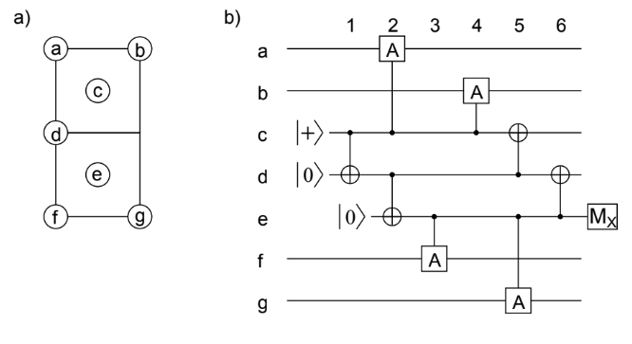
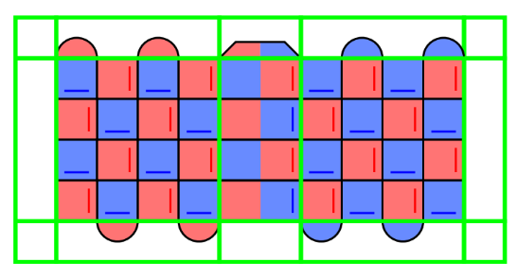
See Crumble circuits in notes
Notes:
https://algassert.com/crumble#circuit=Q(0,4)0;Q(0,8)1;Q(1,1)2;Q(1,3)3;Q(1,5)4;Q(1,7)5;Q(1,9)6;Q(2,0)7;Q(2,2)8;Q(2,4)9;Q(2,6)10;Q(2,8)11;Q(3,1)12;Q(3,3)13;Q(3,5)14;Q(3,7)15;Q(3,9)16;Q(4,2)17;Q(4,4)18;Q(4,6)19;Q(4,8)20;Q(4,10)21;Q(5,1)22;Q(5,3)23;Q(5,5)24;Q(5,7)25;Q(5,9)26;Q(6,0)27;Q(6,2)28;Q(6,4)29;Q(6,6)30;Q(6,8)31;Q(7,1)32;Q(7,3)33;Q(7,5)34;Q(7,7)35;Q(7,9)36;Q(8,2)37;Q(8,4)38;Q(8,6)39;Q(8,8)40;Q(8,10)41;Q(9,1)42;Q(9,3)43;Q(9,5)44;Q(9,7)45;Q(9,9)46;Q(10,0)47;Q(10,2)48;Q(10,4)49;Q(10,6)50;Q(10,8)51;Q(11,1)52;Q(11,3)53;Q(11,5)54;Q(11,7)55;Q(11,9)56;Q(12,0)57;Q(12,2)58;Q(12,4)59;Q(12,6)60;Q(12,8)61;Q(13,1)62;Q(13,3)63;Q(13,5)64;Q(13,7)65;Q(13,9)66;Q(14,2)67;Q(14,4)68;Q(14,6)69;Q(14,8)70;Q(14,10)71;Q(15,1)72;Q(15,3)73;Q(15,5)74;Q(15,7)75;Q(15,9)76;Q(16,0)77;Q(16,2)78;Q(16,4)79;Q(16,6)80;Q(16,8)81;Q(17,1)82;Q(17,3)83;Q(17,5)84;Q(17,7)85;Q(17,9)86;Q(18,2)87;Q(18,4)88;Q(18,6)89;Q(18,8)90;Q(18,10)91;Q(19,1)92;Q(19,3)93;Q(19,5)94;Q(19,7)95;Q(19,9)96;Q(20,0)97;Q(20,2)98;Q(20,4)99;Q(20,6)100;Q(20,8)101;Q(21,1)102;Q(21,3)103;Q(21,5)104;Q(21,7)105;Q(21,9)106;Q(22,4)107;Q(22,8)108;R_2_3_4_5_6_12_13_14_15_16_22_23_24_25_26_32_33_34_35_36_42_43_44_45_46_52_53_54_55_56_57_58_59_60_61;RX_0_1_7_8_9_10_11_17_18_19_20_21_27_28_29_30_31_37_38_39_40_41_47_48_49_50_51_62_63_64_65_66_67_68_69_70_71_72_73_74_75_76_77_78_79_80_81_82_83_84_85_86_87_88_89_90_91_92_93_94_95_96_97_98_99_100_101_102_103_104_105_106_107_108;TICK;CX_47_52_48_53_49_54_50_55_51_56;TICK;CX_9_3_11_5_17_12_19_14_21_16_29_23_31_25_37_32_39_34_41_36_49_43_51_45_52_57_53_58_54_59_55_60_56_61;CZ_67_62_69_64_71_66_79_73_81_75_87_82_89_84_91_86_99_93_101_95;TICK;CX_7_12_9_14_11_16_17_23_19_25_27_32_29_34_31_36_37_43_39_45;CZ_57_62_59_64_61_66_67_73_69_75_77_82_79_84_81_86_87_93_89_95_97_102_99_104_101_106;TICK;CX_7_2_9_4_11_6_17_13_19_15_27_22_29_24_31_26_37_33_39_35_47_42_49_44_51_46_68_64_70_66_78_73_80_75_88_84_90_86_98_93_100_95_107_104_108_106;CZ_8_3_10_5_18_14_20_16_28_23_30_25_38_34_40_36_48_43_50_45_67_63_69_65_77_72_79_74_81_76_87_83_89_85_97_92_99_94_101_96;TICK;CX_9_13_11_15_17_22_19_24_21_26_29_33_31_35_37_42_39_44_41_46_58_62_60_64_68_73_70_75_78_82_80_84_88_93_90_95_98_102_100_104;CZ_0_3_1_5_8_12_10_14_18_23_20_25_28_32_30_34_38_43_40_45_59_63_61_65_67_72_69_74_71_76_79_83_81_85_87_92_89_94_91_96_99_103_101_105;TICK;CX_58_63_60_65_68_74_70_76_78_83_80_85_88_94_90_96_98_103_100_105;CZ_0_4_1_6_8_13_10_15_18_24_20_26_28_33_30_35_38_44_40_46;TICK;CX_68_63_70_65_78_72_80_74_88_83_90_85_98_92_100_94_107_103_108_105;CZ_8_2_10_4_18_13_20_15_28_22_30_24_38_33_40_35_48_42_50_44;TICK;CX_52_47_53_48_54_49_55_50_56_51;TICK;CX_57_52_58_53_59_54_60_55_61_56;M_47_48_49_50_51;MX_0_1_7_8_9_10_11_17_18_19_20_21_27_28_29_30_31_37_38_39_40_41_67_68_69_70_71_77_78_79_80_81_87_88_89_90_91_97_98_99_100_101_107_108;DT(10,0,0)rec[-49];DT(10,2,0)rec[-48];DT(10,4,0)rec[-47];DT(10,6,0)rec[-46];DT(10,8,0)rec[-45];DT(0,4,0)rec[-44];DT(0,8,0)rec[-43];DT(2,2,0)rec[-41];DT(2,6,0)rec[-39];DT(4,4,0)rec[-36];DT(4,8,0)rec[-34];DT(6,2,0)rec[-31];DT(6,6,0)rec[-29];DT(8,4,0)rec[-26];DT(8,8,0)rec[-24];DT(14,4,0)rec[-21];DT(14,8,0)rec[-19];DT(16,2,0)rec[-16];DT(16,6,0)rec[-14];DT(18,4,0)rec[-11];DT(18,8,0)rec[-9];DT(20,2,0)rec[-6];DT(20,6,0)rec[-4];DT(22,4,0)rec[-2];DT(22,8,0)rec[-1];TICK;M_52_53_54_55_56;MX_57_58_59_60_61;DT(11,1,1)rec[-10];DT(11,3,1)rec[-9];DT(11,5,1)rec[-8];DT(11,7,1)rec[-7];DT(11,9,1)rec[-6];DT(12,2,1)rec[-4];DT(12,6,1)rec[-2];TICK;R_52_53_54_55_56_57_58_59_60_61;RX_0_1_7_8_9_10_11_17_18_19_20_21_27_28_29_30_31_37_38_39_40_41_47_48_49_50_51_67_68_69_70_71_77_78_79_80_81_87_88_89_90_91_97_98_99_100_101_107_108;TICK;CX_47_52_48_53_49_54_50_55_51_56;TICK;CX_9_3_11_5_17_12_19_14_21_16_29_23_31_25_37_32_39_34_41_36_49_43_51_45_52_57_53_58_54_59_55_60_56_61;CZ_67_62_69_64_71_66_79_73_81_75_87_82_89_84_91_86_99_93_101_95;TICK;CX_7_12_9_14_11_16_17_23_19_25_27_32_29_34_31_36_37_43_39_45;CZ_57_62_59_64_61_66_67_73_69_75_77_82_79_84_81_86_87_93_89_95_97_102_99_104_101_106;TICK;CX_7_2_9_4_11_6_17_13_19_15_27_22_29_24_31_26_37_33_39_35_47_42_49_44_51_46_68_64_70_66_78_73_80_75_88_84_90_86_98_93_100_95_107_104_108_106;CZ_8_3_10_5_18_14_20_16_28_23_30_25_38_34_40_36_48_43_50_45_67_63_69_65_77_72_79_74_81_76_87_83_89_85_97_92_99_94_101_96;TICK;CX_9_13_11_15_17_22_19_24_21_26_29_33_31_35_37_42_39_44_41_46_58_62_60_64_68_73_70_75_78_82_80_84_88_93_90_95_98_102_100_104;CZ_0_3_1_5_8_12_10_14_18_23_20_25_28_32_30_34_38_43_40_45_59_63_61_65_67_72_69_74_71_76_79_83_81_85_87_92_89_94_91_96_99_103_101_105;TICK;CX_58_63_60_65_68_74_70_76_78_83_80_85_88_94_90_96_98_103_100_105;CZ_0_4_1_6_8_13_10_15_18_24_20_26_28_33_30_35_38_44_40_46;TICK;CX_68_63_70_65_78_72_80_74_88_83_90_85_98_92_100_94_107_103_108_105;CZ_8_2_10_4_18_13_20_15_28_22_30_24_38_33_40_35_48_42_50_44;TICK;CX_52_47_53_48_54_49_55_50_56_51;TICK;CX_57_52_58_53_59_54_60_55_61_56;M_47_48_49_50_51;MX_0_1_7_8_9_10_11_17_18_19_20_21_27_28_29_30_31_37_38_39_40_41_67_68_69_70_71_77_78_79_80_81_87_88_89_90_91_97_98_99_100_101_107_108;DT(10,0,2)rec[-49];DT(10,2,2)rec[-48];DT(10,4,2)rec[-47];DT(10,6,2)rec[-46];DT(10,8,2)rec[-45];DT(0,4,2)rec[-44]_rec[-103];DT(0,8,2)rec[-43]_rec[-102];DT(2,0,2)rec[-42]_rec[-101];DT(2,2,2)rec[-41]_rec[-100];DT(2,4,2)rec[-40]_rec[-99];DT(2,6,2)rec[-39]_rec[-98];DT(2,8,2)rec[-38]_rec[-97];DT(4,2,2)rec[-37]_rec[-96];DT(4,4,2)rec[-36]_rec[-95];DT(4,6,2)rec[-35]_rec[-94];DT(4,8,2)rec[-34]_rec[-93];DT(4,10,2)rec[-33]_rec[-92];DT(6,0,2)rec[-32]_rec[-91];DT(6,2,2)rec[-31]_rec[-90];DT(6,4,2)rec[-30]_rec[-89];DT(6,6,2)rec[-29]_rec[-88];DT(6,8,2)rec[-28]_rec[-87];DT(8,2,2)rec[-27]_rec[-86];DT(8,4,2)rec[-26]_rec[-85];DT(8,6,2)rec[-25]_rec[-84];DT(8,8,2)rec[-24]_rec[-83];DT(8,10,2)rec[-23]_rec[-82];DT(14,2,2)rec[-22]_rec[-81];DT(14,4,2)rec[-21]_rec[-80];DT(14,6,2)rec[-20]_rec[-79];DT(14,8,2)rec[-19]_rec[-78];DT(14,10,2)rec[-18]_rec[-77];DT(16,0,2)rec[-17]_rec[-76];DT(16,2,2)rec[-16]_rec[-75];DT(16,4,2)rec[-15]_rec[-74];DT(16,6,2)rec[-14]_rec[-73];DT(16,8,2)rec[-13]_rec[-72];DT(18,2,2)rec[-12]_rec[-71];DT(18,4,2)rec[-11]_rec[-70];DT(18,6,2)rec[-10]_rec[-69];DT(18,8,2)rec[-9]_rec[-68];DT(18,10,2)rec[-8]_rec[-67];DT(20,0,2)rec[-7]_rec[-66];DT(20,2,2)rec[-6]_rec[-65];DT(20,4,2)rec[-5]_rec[-64];DT(20,6,2)rec[-4]_rec[-63];DT(20,8,2)rec[-3]_rec[-62];DT(22,4,2)rec[-2]_rec[-61];DT(22,8,2)rec[-1]_rec[-60];TICK;M_52_53_54_55_56;MX_57_58_59_60_61;DT(11,1,3)rec[-10];DT(11,3,3)rec[-9];DT(11,5,3)rec[-8];DT(11,7,3)rec[-7];DT(11,9,3)rec[-6];DT(12,0,3)rec[-5]_rec[-64];DT(12,2,3)rec[-4]_rec[-63];DT(12,4,3)rec[-3]_rec[-62];DT(12,6,3)rec[-2]_rec[-61];DT(12,8,3)rec[-1]_rec[-60];TICK;R_52_53_54_55_56_57_58_59_60_61;RX_0_1_7_8_9_10_11_17_18_19_20_21_27_28_29_30_31_37_38_39_40_41_47_48_49_50_51_67_68_69_70_71_77_78_79_80_81_87_88_89_90_91_97_98_99_100_101_107_108;TICK;CX_47_52_48_53_49_54_50_55_51_56;TICK;CX_9_3_11_5_17_12_19_14_21_16_29_23_31_25_37_32_39_34_41_36_49_43_51_45_52_57_53_58_54_59_55_60_56_61;CZ_67_62_69_64_71_66_79_73_81_75_87_82_89_84_91_86_99_93_101_95;TICK;CX_7_12_9_14_11_16_17_23_19_25_27_32_29_34_31_36_37_43_39_45;CZ_57_62_59_64_61_66_67_73_69_75_77_82_79_84_81_86_87_93_89_95_97_102_99_104_101_106;TICK;CX_7_2_9_4_11_6_17_13_19_15_27_22_29_24_31_26_37_33_39_35_47_42_49_44_51_46_68_64_70_66_78_73_80_75_88_84_90_86_98_93_100_95_107_104_108_106;CZ_8_3_10_5_18_14_20_16_28_23_30_25_38_34_40_36_48_43_50_45_67_63_69_65_77_72_79_74_81_76_87_83_89_85_97_92_99_94_101_96;TICK;CX_9_13_11_15_17_22_19_24_21_26_29_33_31_35_37_42_39_44_41_46_58_62_60_64_68_73_70_75_78_82_80_84_88_93_90_95_98_102_100_104;CZ_0_3_1_5_8_12_10_14_18_23_20_25_28_32_30_34_38_43_40_45_59_63_61_65_67_72_69_74_71_76_79_83_81_85_87_92_89_94_91_96_99_103_101_105;TICK;CX_58_63_60_65_68_74_70_76_78_83_80_85_88_94_90_96_98_103_100_105;CZ_0_4_1_6_8_13_10_15_18_24_20_26_28_33_30_35_38_44_40_46;TICK;CX_68_63_70_65_78_72_80_74_88_83_90_85_98_92_100_94_107_103_108_105;CZ_8_2_10_4_18_13_20_15_28_22_30_24_38_33_40_35_48_42_50_44;TICK;CX_52_47_53_48_54_49_55_50_56_51;TICK;CX_57_52_58_53_59_54_60_55_61_56;M_47_48_49_50_51;MX_0_1_7_8_9_10_11_17_18_19_20_21_27_28_29_30_31_37_38_39_40_41_67_68_69_70_71_77_78_79_80_81_87_88_89_90_91_97_98_99_100_101_107_108;DT(10,0,4)rec[-49];DT(10,2,4)rec[-48];DT(10,4,4)rec[-47];DT(10,6,4)rec[-46];DT(10,8,4)rec[-45];DT(0,4,4)rec[-44]_rec[-103];DT(0,8,4)rec[-43]_rec[-102];DT(2,0,4)rec[-42]_rec[-101];DT(2,2,4)rec[-41]_rec[-100];DT(2,4,4)rec[-40]_rec[-99];DT(2,6,4)rec[-39]_rec[-98];DT(2,8,4)rec[-38]_rec[-97];DT(4,2,4)rec[-37]_rec[-96];DT(4,4,4)rec[-36]_rec[-95];DT(4,6,4)rec[-35]_rec[-94];DT(4,8,4)rec[-34]_rec[-93];DT(4,10,4)rec[-33]_rec[-92];DT(6,0,4)rec[-32]_rec[-91];DT(6,2,4)rec[-31]_rec[-90];DT(6,4,4)rec[-30]_rec[-89];DT(6,6,4)rec[-29]_rec[-88];DT(6,8,4)rec[-28]_rec[-87];DT(8,2,4)rec[-27]_rec[-86];DT(8,4,4)rec[-26]_rec[-85];DT(8,6,4)rec[-25]_rec[-84];DT(8,8,4)rec[-24]_rec[-83];DT(8,10,4)rec[-23]_rec[-82];DT(14,2,4)rec[-22]_rec[-81];DT(14,4,4)rec[-21]_rec[-80];DT(14,6,4)rec[-20]_rec[-79];DT(14,8,4)rec[-19]_rec[-78];DT(14,10,4)rec[-18]_rec[-77];DT(16,0,4)rec[-17]_rec[-76];DT(16,2,4)rec[-16]_rec[-75];DT(16,4,4)rec[-15]_rec[-74];DT(16,6,4)rec[-14]_rec[-73];DT(16,8,4)rec[-13]_rec[-72];DT(18,2,4)rec[-12]_rec[-71];DT(18,4,4)rec[-11]_rec[-70];DT(18,6,4)rec[-10]_rec[-69];DT(18,8,4)rec[-9]_rec[-68];DT(18,10,4)rec[-8]_rec[-67];DT(20,0,4)rec[-7]_rec[-66];DT(20,2,4)rec[-6]_rec[-65];DT(20,4,4)rec[-5]_rec[-64];DT(20,6,4)rec[-4]_rec[-63];DT(20,8,4)rec[-3]_rec[-62];DT(22,4,4)rec[-2]_rec[-61];DT(22,8,4)rec[-1]_rec[-60];TICK;M_52_53_54_55_56;MX_57_58_59_60_61;DT(11,1,5)rec[-10];DT(11,3,5)rec[-9];DT(11,5,5)rec[-8];DT(11,7,5)rec[-7];DT(11,9,5)rec[-6];DT(12,0,5)rec[-5]_rec[-64];DT(12,2,5)rec[-4]_rec[-63];DT(12,4,5)rec[-3]_rec[-62];DT(12,6,5)rec[-2]_rec[-61];DT(12,8,5)rec[-1]_rec[-60];TICK;R_52_53_54_55_56_57_58_59_60_61;RX_0_1_7_8_9_10_11_17_18_19_20_21_27_28_29_30_31_37_38_39_40_41_47_48_49_50_51_67_68_69_70_71_77_78_79_80_81_87_88_89_90_91_97_98_99_100_101_107_108;TICK;CX_47_52_48_53_49_54_50_55_51_56;TICK;CX_9_3_11_5_17_12_19_14_21_16_29_23_31_25_37_32_39_34_41_36_49_43_51_45_52_57_53_58_54_59_55_60_56_61;CZ_67_62_69_64_71_66_79_73_81_75_87_82_89_84_91_86_99_93_101_95;TICK;CX_7_12_9_14_11_16_17_23_19_25_27_32_29_34_31_36_37_43_39_45;CZ_57_62_59_64_61_66_67_73_69_75_77_82_79_84_81_86_87_93_89_95_97_102_99_104_101_106;TICK;CX_7_2_9_4_11_6_17_13_19_15_27_22_29_24_31_26_37_33_39_35_47_42_49_44_51_46_68_64_70_66_78_73_80_75_88_84_90_86_98_93_100_95_107_104_108_106;CZ_8_3_10_5_18_14_20_16_28_23_30_25_38_34_40_36_48_43_50_45_67_63_69_65_77_72_79_74_81_76_87_83_89_85_97_92_99_94_101_96;TICK;CX_9_13_11_15_17_22_19_24_21_26_29_33_31_35_37_42_39_44_41_46_58_62_60_64_68_73_70_75_78_82_80_84_88_93_90_95_98_102_100_104;CZ_0_3_1_5_8_12_10_14_18_23_20_25_28_32_30_34_38_43_40_45_59_63_61_65_67_72_69_74_71_76_79_83_81_85_87_92_89_94_91_96_99_103_101_105;TICK;CX_58_63_60_65_68_74_70_76_78_83_80_85_88_94_90_96_98_103_100_105;CZ_0_4_1_6_8_13_10_15_18_24_20_26_28_33_30_35_38_44_40_46;TICK;CX_68_63_70_65_78_72_80_74_88_83_90_85_98_92_100_94_107_103_108_105;CZ_8_2_10_4_18_13_20_15_28_22_30_24_38_33_40_35_48_42_50_44;TICK;CX_52_47_53_48_54_49_55_50_56_51;TICK;CX_57_52_58_53_59_54_60_55_61_56;M_47_48_49_50_51;MX_0_1_7_8_9_10_11_17_18_19_20_21_27_28_29_30_31_37_38_39_40_41_67_68_69_70_71_77_78_79_80_81_87_88_89_90_91_97_98_99_100_101_107_108;DT(10,0,6)rec[-49];DT(10,2,6)rec[-48];DT(10,4,6)rec[-47];DT(10,6,6)rec[-46];DT(10,8,6)rec[-45];DT(0,4,6)rec[-44]_rec[-103];DT(0,8,6)rec[-43]_rec[-102];DT(2,0,6)rec[-42]_rec[-101];DT(2,2,6)rec[-41]_rec[-100];DT(2,4,6)rec[-40]_rec[-99];DT(2,6,6)rec[-39]_rec[-98];DT(2,8,6)rec[-38]_rec[-97];DT(4,2,6)rec[-37]_rec[-96];DT(4,4,6)rec[-36]_rec[-95];DT(4,6,6)rec[-35]_rec[-94];DT(4,8,6)rec[-34]_rec[-93];DT(4,10,6)rec[-33]_rec[-92];DT(6,0,6)rec[-32]_rec[-91];DT(6,2,6)rec[-31]_rec[-90];DT(6,4,6)rec[-30]_rec[-89];DT(6,6,6)rec[-29]_rec[-88];DT(6,8,6)rec[-28]_rec[-87];DT(8,2,6)rec[-27]_rec[-86];DT(8,4,6)rec[-26]_rec[-85];DT(8,6,6)rec[-25]_rec[-84];DT(8,8,6)rec[-24]_rec[-83];DT(8,10,6)rec[-23]_rec[-82];DT(14,2,6)rec[-22]_rec[-81];DT(14,4,6)rec[-21]_rec[-80];DT(14,6,6)rec[-20]_rec[-79];DT(14,8,6)rec[-19]_rec[-78];DT(14,10,6)rec[-18]_rec[-77];DT(16,0,6)rec[-17]_rec[-76];DT(16,2,6)rec[-16]_rec[-75];DT(16,4,6)rec[-15]_rec[-74];DT(16,6,6)rec[-14]_rec[-73];DT(16,8,6)rec[-13]_rec[-72];DT(18,2,6)rec[-12]_rec[-71];DT(18,4,6)rec[-11]_rec[-70];DT(18,6,6)rec[-10]_rec[-69];DT(18,8,6)rec[-9]_rec[-68];DT(18,10,6)rec[-8]_rec[-67];DT(20,0,6)rec[-7]_rec[-66];DT(20,2,6)rec[-6]_rec[-65];DT(20,4,6)rec[-5]_rec[-64];DT(20,6,6)rec[-4]_rec[-63];DT(20,8,6)rec[-3]_rec[-62];DT(22,4,6)rec[-2]_rec[-61];DT(22,8,6)rec[-1]_rec[-60];TICK;M_52_53_54_55_56;MX_57_58_59_60_61;DT(11,1,7)rec[-10];DT(11,3,7)rec[-9];DT(11,5,7)rec[-8];DT(11,7,7)rec[-7];DT(11,9,7)rec[-6];DT(12,0,7)rec[-5]_rec[-64];DT(12,2,7)rec[-4]_rec[-63];DT(12,4,7)rec[-3]_rec[-62];DT(12,6,7)rec[-2]_rec[-61];DT(12,8,7)rec[-1]_rec[-60];TICK;R_52_53_54_55_56_57_58_59_60_61;RX_0_1_7_8_9_10_11_17_18_19_20_21_27_28_29_30_31_37_38_39_40_41_47_48_49_50_51_67_68_69_70_71_77_78_79_80_81_87_88_89_90_91_97_98_99_100_101_107_108;TICK;CX_47_52_48_53_49_54_50_55_51_56;TICK;CX_9_3_11_5_17_12_19_14_21_16_29_23_31_25_37_32_39_34_41_36_49_43_51_45_52_57_53_58_54_59_55_60_56_61;CZ_67_62_69_64_71_66_79_73_81_75_87_82_89_84_91_86_99_93_101_95;TICK;CX_7_12_9_14_11_16_17_23_19_25_27_32_29_34_31_36_37_43_39_45;CZ_57_62_59_64_61_66_67_73_69_75_77_82_79_84_81_86_87_93_89_95_97_102_99_104_101_106;TICK;CX_7_2_9_4_11_6_17_13_19_15_27_22_29_24_31_26_37_33_39_35_47_42_49_44_51_46_68_64_70_66_78_73_80_75_88_84_90_86_98_93_100_95_107_104_108_106;CZ_8_3_10_5_18_14_20_16_28_23_30_25_38_34_40_36_48_43_50_45_67_63_69_65_77_72_79_74_81_76_87_83_89_85_97_92_99_94_101_96;TICK;CX_9_13_11_15_17_22_19_24_21_26_29_33_31_35_37_42_39_44_41_46_58_62_60_64_68_73_70_75_78_82_80_84_88_93_90_95_98_102_100_104;CZ_0_3_1_5_8_12_10_14_18_23_20_25_28_32_30_34_38_43_40_45_59_63_61_65_67_72_69_74_71_76_79_83_81_85_87_92_89_94_91_96_99_103_101_105;TICK;CX_58_63_60_65_68_74_70_76_78_83_80_85_88_94_90_96_98_103_100_105;CZ_0_4_1_6_8_13_10_15_18_24_20_26_28_33_30_35_38_44_40_46;TICK;CX_68_63_70_65_78_72_80_74_88_83_90_85_98_92_100_94_107_103_108_105;CZ_8_2_10_4_18_13_20_15_28_22_30_24_38_33_40_35_48_42_50_44;TICK;CX_52_47_53_48_54_49_55_50_56_51;TICK;CX_57_52_58_53_59_54_60_55_61_56;M_2_3_4_5_6_12_13_14_15_16_22_23_24_25_26_32_33_34_35_36_42_43_44_45_46_47_48_49_50_51;MX_0_1_7_8_9_10_11_17_18_19_20_21_27_28_29_30_31_37_38_39_40_41_62_63_64_65_66_67_68_69_70_71_72_73_74_75_76_77_78_79_80_81_82_83_84_85_86_87_88_89_90_91_92_93_94_95_96_97_98_99_100_101_102_103_104_105_106_107_108;DT(10,0,8)rec[-74];DT(10,2,8)rec[-73];DT(10,4,8)rec[-72];DT(10,6,8)rec[-71];DT(10,8,8)rec[-70];DT(0,4,8)rec[-69]_rec[-97]_rec[-98];DT(0,4,9)rec[-69]_rec[-153];DT(0,8,8)rec[-68]_rec[-95]_rec[-96];DT(0,8,9)rec[-68]_rec[-152];DT(2,0,8)rec[-67]_rec[-151];DT(2,2,8)rec[-66]_rec[-93]_rec[-94]_rec[-98]_rec[-99];DT(2,2,9)rec[-66]_rec[-150];DT(2,4,8)rec[-65]_rec[-149];DT(2,6,8)rec[-64]_rec[-91]_rec[-92]_rec[-96]_rec[-97];DT(2,6,9)rec[-64]_rec[-148];DT(2,8,8)rec[-63]_rec[-147];DT(4,2,8)rec[-62]_rec[-146];DT(4,4,8)rec[-61]_rec[-87]_rec[-88]_rec[-92]_rec[-93];DT(4,4,9)rec[-61]_rec[-145];DT(4,6,8)rec[-60]_rec[-144];DT(4,8,8)rec[-59]_rec[-85]_rec[-86]_rec[-90]_rec[-91];DT(4,8,9)rec[-59]_rec[-143];DT(4,10,8)rec[-58]_rec[-142];DT(6,0,8)rec[-57]_rec[-141];DT(6,2,8)rec[-56]_rec[-140];DT(5,1,8)rec[-56]_rec[-83]_rec[-84]_rec[-88]_rec[-89];DT(6,4,8)rec[-55]_rec[-139];DT(6,6,8)rec[-54]_rec[-81]_rec[-82]_rec[-86]_rec[-87];DT(6,6,9)rec[-54]_rec[-138];DT(6,8,8)rec[-53]_rec[-137];DT(8,2,8)rec[-52]_rec[-136];DT(8,4,8)rec[-51]_rec[-77]_rec[-78]_rec[-82]_rec[-83];DT(8,4,9)rec[-51]_rec[-135];DT(8,6,8)rec[-50]_rec[-134];DT(8,8,8)rec[-49]_rec[-133];DT(7,7,8)rec[-49]_rec[-75]_rec[-76]_rec[-80]_rec[-81];DT(8,10,8)rec[-48]_rec[-132];DT(14,2,8)rec[-42]_rec[-131];DT(14,4,8)rec[-41]_rec[-130];DT(14,6,8)rec[-40]_rec[-129];DT(14,8,8)rec[-39]_rec[-128];DT(14,10,8)rec[-38]_rec[-127];DT(13,3,8)rec[-35]_rec[-36]_rec[-41]_rec[-45]_rec[-46];DT(13,7,8)rec[-33]_rec[-34]_rec[-39]_rec[-43]_rec[-44];DT(16,0,8)rec[-32]_rec[-126];DT(16,2,8)rec[-31]_rec[-125];DT(16,4,8)rec[-30]_rec[-124];DT(16,6,8)rec[-29]_rec[-123];DT(16,8,8)rec[-28]_rec[-122];DT(15,1,8)rec[-26]_rec[-27]_rec[-31]_rec[-36]_rec[-37];DT(15,5,8)rec[-24]_rec[-25]_rec[-29]_rec[-34]_rec[-35];DT(18,2,8)rec[-22]_rec[-121];DT(18,4,8)rec[-21]_rec[-120];DT(18,6,8)rec[-20]_rec[-119];DT(18,8,8)rec[-19]_rec[-118];DT(18,10,8)rec[-18]_rec[-117];DT(17,3,8)rec[-15]_rec[-16]_rec[-21]_rec[-25]_rec[-26];DT(17,7,8)rec[-13]_rec[-14]_rec[-19]_rec[-23]_rec[-24];DT(20,0,8)rec[-12]_rec[-116];DT(20,2,8)rec[-11]_rec[-115];DT(20,4,8)rec[-10]_rec[-114];DT(20,6,8)rec[-9]_rec[-113];DT(20,8,8)rec[-8]_rec[-112];DT(19,1,8)rec[-6]_rec[-7]_rec[-11]_rec[-16]_rec[-17];DT(19,5,8)rec[-4]_rec[-5]_rec[-9]_rec[-14]_rec[-15];DT(21,3,8)rec[-2]_rec[-5]_rec[-6];DT(22,4,8)rec[-2]_rec[-111];DT(22,8,8)rec[-1]_rec[-110];DT(21,7,8)rec[-1]_rec[-3]_rec[-4];OI(0)rec[-5]_rec[-15]_rec[-25]_rec[-35]_rec[-45]_rec[-77]_rec[-82]_rec[-87]_rec[-92]_rec[-97];TICK;M_52_53_54_55_56;MX_57_58_59_60_61;DT(11,1,10)rec[-10];DT(11,3,10)rec[-9];DT(11,5,10)rec[-8];DT(11,7,10)rec[-7];DT(11,9,10)rec[-6];DT(12,0,10)rec[-5]_rec[-114];DT(13,1,10)rec[-4]_rec[-56]_rec[-57]_rec[-88]_rec[-89];DT(12,2,10)rec[-4]_rec[-113];DT(12,4,10)rec[-3]_rec[-112];DT(13,5,10)rec[-2]_rec[-54]_rec[-55]_rec[-86]_rec[-87];DT(12,6,10)rec[-2]_rec[-111];DT(12,8,10)rec[-1]_rec[-110]

Slide 8






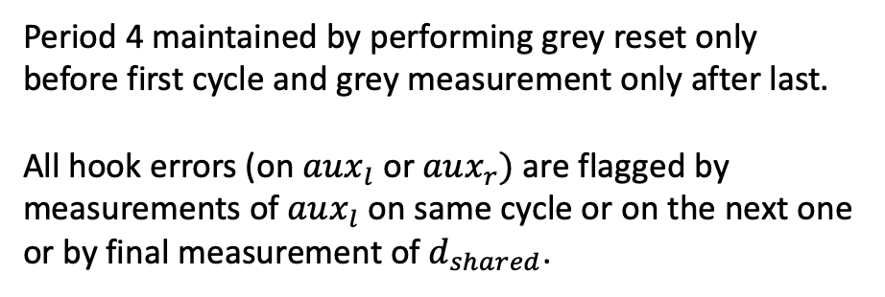

See Crumble circuits in notes
Period 4 maintained by performing grey reset only before first cycle and grey measurement only after last.
All hook errors (on $aux_{l}$ or $aux_{r})$ are flagged by measurements of $aux_{l}$ on same cycle or on the next one or by final measurement of $d_{shared}$.
$$d_{tl}$$
$$d_{tr}$$
$${aux}_{l}$$
$${aux}_{r}$$
$$d_{bl}$$
$$d_{shared}$$
$$d_{br}$$
Notes:
https://algassert.com/crumble#circuit=Q(0,0)0;Q(0,2)1;Q(0,4)2;Q(0,6)3;Q(0,8)4;Q(0,10)5;Q(1,1)6;Q(1,3)7;Q(1,5)8;Q(1,7)9;Q(1,9)10;Q(2,0)11;Q(2,2)12;Q(2,4)13;Q(2,6)14;Q(2,8)15;Q(2,10)16;Q(3,1)17;Q(3,3)18;Q(3,5)19;Q(3,7)20;Q(3,9)21;Q(4,0)22;Q(4,2)23;Q(4,4)24;Q(4,6)25;Q(4,8)26;Q(4,10)27;Q(5,1)28;Q(5,3)29;Q(5,5)30;Q(5,7)31;Q(5,9)32;Q(6,0)33;Q(6,2)34;Q(6,4)35;Q(6,6)36;Q(6,8)37;Q(6,10)38;Q(7,1)39;Q(7,3)40;Q(7,5)41;Q(7,7)42;Q(7,9)43;Q(8,0)44;Q(8,2)45;Q(8,4)46;Q(8,6)47;Q(8,8)48;Q(8,10)49;Q(9,1)50;Q(9,3)51;Q(9,5)52;Q(9,7)53;Q(9,9)54;Q(10,0)55;Q(10,2)56;Q(10,4)57;Q(10,6)58;Q(10,8)59;Q(10,10)60;Q(11,1)61;Q(11,3)62;Q(11,5)63;Q(11,7)64;Q(11,9)65;Q(12,0)66;Q(12,2)67;Q(12,4)68;Q(12,6)69;Q(12,8)70;Q(12,10)71;Q(13,1)72;Q(13,3)73;Q(13,5)74;Q(13,7)75;Q(13,9)76;Q(14,0)77;Q(14,2)78;Q(14,4)79;Q(14,6)80;Q(14,8)81;Q(14,10)82;Q(15,1)83;Q(15,3)84;Q(15,5)85;Q(15,7)86;Q(15,9)87;Q(16,0)88;Q(16,2)89;Q(16,4)90;Q(16,6)91;Q(16,8)92;Q(16,10)93;Q(17,1)94;Q(17,3)95;Q(17,5)96;Q(17,7)97;Q(17,9)98;Q(18,0)99;Q(18,2)100;Q(18,4)101;Q(18,6)102;Q(18,8)103;Q(18,10)104;Q(19,1)105;Q(19,3)106;Q(19,5)107;Q(19,7)108;Q(19,9)109;Q(20,0)110;Q(20,2)111;Q(20,4)112;Q(20,6)113;Q(20,8)114;Q(20,10)115;Q(21,1)116;Q(21,3)117;Q(21,5)118;Q(21,7)119;Q(21,9)120;Q(22,0)121;Q(22,2)122;Q(22,4)123;Q(22,6)124;Q(22,8)125;Q(22,10)126;RX_2_4_11_12_13_14_15_23_24_25_26_27_33_34_35_36_37_45_46_47_48_49_56_58_66_68_70_72_73_74_75_76_78_79_80_81_82_83_84_85_86_87_88_89_90_91_92_94_95_96_97_98_100_101_102_103_104_105_106_107_108_109_110_111_112_113_114_116_117_118_119_120_123_125;R_6_7_8_9_10_17_18_19_20_21_28_29_30_31_32_39_40_41_42_43_50_51_52_53_54_55_57_59_61_62_63_64_65_67_69;X_ERROR(0.001)6_7_8_9_10_17_18_19_20_21_28_29_30_31_32_39_40_41_42_43_50_51_52_53_54_55_57_59_61_62_63_64_65_67_69;Z_ERROR(0.001)2_4_11_12_13_14_15_23_24_25_26_27_33_34_35_36_37_45_46_47_48_49_56_58_66_68_70_72_73_74_75_76_78_79_80_81_82_83_84_85_86_87_88_89_90_91_92_94_95_96_97_98_100_101_102_103_104_105_106_107_108_109_110_111_112_113_114_116_117_118_119_120_123_125;DEPOLARIZE1(0.001)0_1_3_5_16_22_38_44_60_71_77_93_99_115_121_122_124_126;TICK;CX_56_62_58_64_66_61_68_63_70_65;CZ_12_6_14_8_24_18_26_20_34_28_36_30_46_40_48_42_78_72_80_74_82_76_90_84_92_86_100_94_102_96_104_98_112_106_114_108;DEPOLARIZE2(0.001)56_62_58_64_66_61_68_63_70_65_12_6_14_8_24_18_26_20_34_28_36_30_46_40_48_42_78_72_80_74_82_76_90_84_92_86_100_94_102_96_104_98_112_106_114_108;DEPOLARIZE1(0.001)0_1_2_3_4_5_7_9_10_11_13_15_16_17_19_21_22_23_25_27_29_31_32_33_35_37_38_39_41_43_44_45_47_49_50_51_52_53_54_55_57_59_60_67_69_71_73_75_77_79_81_83_85_87_88_89_91_93_95_97_99_101_103_105_107_109_110_111_113_115_116_117_118_119_120_121_122_123_124_125_126;TICK;CX_61_55_62_67_63_57_64_69_65_59;CZ_2_8_4_10_12_18_14_20_24_30_26_32_34_40_36_42_46_52_48_54_66_72_68_74_70_76_78_84_80_86_88_94_90_96_92_98_100_106_102_108_110_116_112_118_114_120;DEPOLARIZE2(0.001)61_55_62_67_63_57_64_69_65_59_2_8_4_10_12_18_14_20_24_30_26_32_34_40_36_42_46_52_48_54_66_72_68_74_70_76_78_84_80_86_88_94_90_96_92_98_100_106_102_108_110_116_112_118_114_120;DEPOLARIZE1(0.001)0_1_3_5_6_7_9_11_13_15_16_17_19_21_22_23_25_27_28_29_31_33_35_37_38_39_41_43_44_45_47_49_50_51_53_56_58_60_71_73_75_77_79_81_82_83_85_87_89_91_93_95_97_99_101_103_104_105_107_109_111_113_115_117_119_121_122_123_124_125_126;TICK;CX_55_50_57_52_59_54;CZ_2_7_4_9_12_17_14_19_24_29_26_31_34_39_36_41_46_51_48_53_68_73_70_75_78_83_80_85_82_87_90_95_92_97_100_105_102_107_104_109_112_117_114_119;DEPOLARIZE2(0.001)55_50_57_52_59_54_2_7_4_9_12_17_14_19_24_29_26_31_34_39_36_41_46_51_48_53_68_73_70_75_78_83_80_85_82_87_90_95_92_97_100_105_102_107_104_109_112_117_114_119;DEPOLARIZE1(0.001)0_1_3_5_6_8_10_11_13_15_16_18_20_21_22_23_25_27_28_30_32_33_35_37_38_40_42_43_44_45_47_49_56_58_60_61_62_63_64_65_66_67_69_71_72_74_76_77_79_81_84_86_88_89_91_93_94_96_98_99_101_103_106_108_110_111_113_115_116_118_120_121_122_123_124_125_126;TICK;CX_11_6_13_8_15_10_23_18_25_20_33_28_35_30_37_32_45_40_47_42_57_51_59_53_79_74_81_76_89_84_91_86_101_96_103_98_111_106_113_108_123_118_125_120;CZ_12_7_14_9_24_19_26_21_34_29_36_31_46_41_48_43_56_50_58_52_78_73_80_75_88_83_90_85_92_87_100_95_102_97_110_105_112_107_114_109;DEPOLARIZE2(0.001)11_6_13_8_15_10_23_18_25_20_33_28_35_30_37_32_45_40_47_42_57_51_59_53_79_74_81_76_89_84_91_86_101_96_103_98_111_106_113_108_123_118_125_120_12_7_14_9_24_19_26_21_34_29_36_31_46_41_48_43_56_50_58_52_78_73_80_75_88_83_90_85_92_87_100_95_102_97_110_105_112_107_114_109;DEPOLARIZE1(0.001)0_1_2_3_4_5_16_17_22_27_38_39_44_49_54_55_60_61_62_63_64_65_66_67_68_69_70_71_72_77_82_93_94_99_104_115_116_117_119_121_122_124_126;TICK;CX_13_18_15_20_23_28_25_30_27_32_35_40_37_42_45_50_47_52_49_54_67_72_69_74_79_84_81_86_89_94_91_96_101_106_103_108_111_116_113_118;CZ_56_51_58_53;DEPOLARIZE2(0.001)13_18_15_20_23_28_25_30_27_32_35_40_37_42_45_50_47_52_49_54_67_72_69_74_79_84_81_86_89_94_91_96_101_106_103_108_111_116_113_118_56_51_58_53;DEPOLARIZE1(0.001)0_1_2_3_4_5_6_7_8_9_10_11_12_14_16_17_19_21_22_24_26_29_31_33_34_36_38_39_41_43_44_46_48_55_57_59_60_61_62_63_64_65_66_68_70_71_73_75_76_77_78_80_82_83_85_87_88_90_92_93_95_97_98_99_100_102_104_105_107_109_110_112_114_115_117_119_120_121_122_123_124_125_126;TICK;CX_11_17_13_19_15_21_23_29_25_31_33_39_35_41_37_43_45_51_47_53_61_66_62_56_63_68_64_58_65_70_67_73_69_75_79_85_81_87_89_95_91_97_101_107_103_109_111_117_113_119;DEPOLARIZE2(0.001)11_17_13_19_15_21_23_29_25_31_33_39_35_41_37_43_45_51_47_53_61_66_62_56_63_68_64_58_65_70_67_73_69_75_79_85_81_87_89_95_91_97_101_107_103_109_111_117_113_119;DEPOLARIZE1(0.001)0_1_2_3_4_5_6_7_8_9_10_12_14_16_18_20_22_24_26_27_28_30_32_34_36_38_40_42_44_46_48_49_50_52_54_55_57_59_60_71_72_74_76_77_78_80_82_83_84_86_88_90_92_93_94_96_98_99_100_102_104_105_106_108_110_112_114_115_116_118_120_121_122_123_124_125_126;TICK;CX_13_7_15_9_23_17_25_19_27_21_35_29_37_31_45_39_47_41_49_43_55_61_57_63_59_65_67_62_69_64_79_73_81_75_89_83_91_85_101_95_103_97_111_105_113_107_123_117_125_119;DEPOLARIZE2(0.001)13_7_15_9_23_17_25_19_27_21_35_29_37_31_45_39_47_41_49_43_55_61_57_63_59_65_67_62_69_64_79_73_81_75_89_83_91_85_101_95_103_97_111_105_113_107_123_117_125_119;DEPOLARIZE1(0.001)0_1_2_3_4_5_6_8_10_11_12_14_16_18_20_22_24_26_28_30_32_33_34_36_38_40_42_44_46_48_50_51_52_53_54_56_58_60_66_68_70_71_72_74_76_77_78_80_82_84_86_87_88_90_92_93_94_96_98_99_100_102_104_106_108_109_110_112_114_115_116_118_120_121_122_124_126;TICK;MX(0.001)2_4_11_12_13_14_15_23_24_25_26_27_33_34_35_36_37_45_46_47_48_49_55_57_59_67_69_78_79_80_81_82_88_89_90_91_92_100_101_102_103_104_110_111_112_113_114_123_125;M(0.001)56_58_66_68_70;DEPOLARIZE1(0.001)0_1_3_5_6_7_8_9_10_16_17_18_19_20_21_22_28_29_30_31_32_38_39_40_41_42_43_44_50_51_52_53_54_60_61_62_63_64_65_71_72_73_74_75_76_77_83_84_85_86_87_93_94_95_96_97_98_99_105_106_107_108_109_115_116_117_118_119_120_121_122_124_126;TICK;RX_2_4_11_12_13_14_15_23_24_25_26_27_33_34_35_36_37_45_46_47_48_49_56_58_66_68_70_78_79_80_81_82_88_89_90_91_92_100_101_102_103_104_110_111_112_113_114_123_125;R_55_57_59_67_69;X_ERROR(0.001)55_57_59_67_69;Z_ERROR(0.001)2_4_11_12_13_14_15_23_24_25_26_27_33_34_35_36_37_45_46_47_48_49_56_58_66_68_70_78_79_80_81_82_88_89_90_91_92_100_101_102_103_104_110_111_112_113_114_123_125;DEPOLARIZE1(0.001)0_1_3_5_6_7_8_9_10_16_17_18_19_20_21_22_28_29_30_31_32_38_39_40_41_42_43_44_50_51_52_53_54_60_61_62_63_64_65_71_72_73_74_75_76_77_83_84_85_86_87_93_94_95_96_97_98_99_105_106_107_108_109_115_116_117_118_119_120_121_122_124_126;TICK;CX_56_62_58_64_66_61_68_63_70_65;CZ_12_6_14_8_24_18_26_20_34_28_36_30_46_40_48_42_78_72_80_74_82_76_90_84_92_86_100_94_102_96_104_98_112_106_114_108;DEPOLARIZE2(0.001)56_62_58_64_66_61_68_63_70_65_12_6_14_8_24_18_26_20_34_28_36_30_46_40_48_42_78_72_80_74_82_76_90_84_92_86_100_94_102_96_104_98_112_106_114_108;DEPOLARIZE1(0.001)0_1_2_3_4_5_7_9_10_11_13_15_16_17_19_21_22_23_25_27_29_31_32_33_35_37_38_39_41_43_44_45_47_49_50_51_52_53_54_55_57_59_60_67_69_71_73_75_77_79_81_83_85_87_88_89_91_93_95_97_99_101_103_105_107_109_110_111_113_115_116_117_118_119_120_121_122_123_124_125_126;TICK;CX_61_55_62_67_63_57_64_69_65_59;CZ_2_8_4_10_12_18_14_20_24_30_26_32_34_40_36_42_46_52_48_54_66_72_68_74_70_76_78_84_80_86_88_94_90_96_92_98_100_106_102_108_110_116_112_118_114_120;DEPOLARIZE2(0.001)61_55_62_67_63_57_64_69_65_59_2_8_4_10_12_18_14_20_24_30_26_32_34_40_36_42_46_52_48_54_66_72_68_74_70_76_78_84_80_86_88_94_90_96_92_98_100_106_102_108_110_116_112_118_114_120;DEPOLARIZE1(0.001)0_1_3_5_6_7_9_11_13_15_16_17_19_21_22_23_25_27_28_29_31_33_35_37_38_39_41_43_44_45_47_49_50_51_53_56_58_60_71_73_75_77_79_81_82_83_85_87_89_91_93_95_97_99_101_103_104_105_107_109_111_113_115_117_119_121_122_123_124_125_126;TICK;CX_55_50_57_52_59_54;CZ_2_7_4_9_12_17_14_19_24_29_26_31_34_39_36_41_46_51_48_53_68_73_70_75_78_83_80_85_82_87_90_95_92_97_100_105_102_107_104_109_112_117_114_119;DEPOLARIZE2(0.001)55_50_57_52_59_54_2_7_4_9_12_17_14_19_24_29_26_31_34_39_36_41_46_51_48_53_68_73_70_75_78_83_80_85_82_87_90_95_92_97_100_105_102_107_104_109_112_117_114_119;DEPOLARIZE1(0.001)0_1_3_5_6_8_10_11_13_15_16_18_20_21_22_23_25_27_28_30_32_33_35_37_38_40_42_43_44_45_47_49_56_58_60_61_62_63_64_65_66_67_69_71_72_74_76_77_79_81_84_86_88_89_91_93_94_96_98_99_101_103_106_108_110_111_113_115_116_118_120_121_122_123_124_125_126;TICK;CX_11_6_13_8_15_10_23_18_25_20_33_28_35_30_37_32_45_40_47_42_57_51_59_53_79_74_81_76_89_84_91_86_101_96_103_98_111_106_113_108_123_118_125_120;CZ_12_7_14_9_24_19_26_21_34_29_36_31_46_41_48_43_56_50_58_52_78_73_80_75_88_83_90_85_92_87_100_95_102_97_110_105_112_107_114_109;DEPOLARIZE2(0.001)11_6_13_8_15_10_23_18_25_20_33_28_35_30_37_32_45_40_47_42_57_51_59_53_79_74_81_76_89_84_91_86_101_96_103_98_111_106_113_108_123_118_125_120_12_7_14_9_24_19_26_21_34_29_36_31_46_41_48_43_56_50_58_52_78_73_80_75_88_83_90_85_92_87_100_95_102_97_110_105_112_107_114_109;DEPOLARIZE1(0.001)0_1_2_3_4_5_16_17_22_27_38_39_44_49_54_55_60_61_62_63_64_65_66_67_68_69_70_71_72_77_82_93_94_99_104_115_116_117_119_121_122_124_126;TICK;CX_13_18_15_20_23_28_25_30_27_32_35_40_37_42_45_50_47_52_49_54_67_72_69_74_79_84_81_86_89_94_91_96_101_106_103_108_111_116_113_118;CZ_56_51_58_53;DEPOLARIZE2(0.001)13_18_15_20_23_28_25_30_27_32_35_40_37_42_45_50_47_52_49_54_67_72_69_74_79_84_81_86_89_94_91_96_101_106_103_108_111_116_113_118_56_51_58_53;DEPOLARIZE1(0.001)0_1_2_3_4_5_6_7_8_9_10_11_12_14_16_17_19_21_22_24_26_29_31_33_34_36_38_39_41_43_44_46_48_55_57_59_60_61_62_63_64_65_66_68_70_71_73_75_76_77_78_80_82_83_85_87_88_90_92_93_95_97_98_99_100_102_104_105_107_109_110_112_114_115_117_119_120_121_122_123_124_125_126;TICK;CX_11_17_13_19_15_21_23_29_25_31_33_39_35_41_37_43_45_51_47_53_61_66_62_56_63_68_64_58_65_70_67_73_69_75_79_85_81_87_89_95_91_97_101_107_103_109_111_117_113_119;DEPOLARIZE2(0.001)11_17_13_19_15_21_23_29_25_31_33_39_35_41_37_43_45_51_47_53_61_66_62_56_63_68_64_58_65_70_67_73_69_75_79_85_81_87_89_95_91_97_101_107_103_109_111_117_113_119;DEPOLARIZE1(0.001)0_1_2_3_4_5_6_7_8_9_10_12_14_16_18_20_22_24_26_27_28_30_32_34_36_38_40_42_44_46_48_49_50_52_54_55_57_59_60_71_72_74_76_77_78_80_82_83_84_86_88_90_92_93_94_96_98_99_100_102_104_105_106_108_110_112_114_115_116_118_120_121_122_123_124_125_126;TICK;CX_13_7_15_9_23_17_25_19_27_21_35_29_37_31_45_39_47_41_49_43_55_61_57_63_59_65_67_62_69_64_79_73_81_75_89_83_91_85_101_95_103_97_111_105_113_107_123_117_125_119;DEPOLARIZE2(0.001)13_7_15_9_23_17_25_19_27_21_35_29_37_31_45_39_47_41_49_43_55_61_57_63_59_65_67_62_69_64_79_73_81_75_89_83_91_85_101_95_103_97_111_105_113_107_123_117_125_119;DEPOLARIZE1(0.001)0_1_2_3_4_5_6_8_10_11_12_14_16_18_20_22_24_26_28_30_32_33_34_36_38_40_42_44_46_48_50_51_52_53_54_56_58_60_66_68_70_71_72_74_76_77_78_80_82_84_86_87_88_90_92_93_94_96_98_99_100_102_104_106_108_109_110_112_114_115_116_118_120_121_122_124_126;TICK;MX(0.001)2_4_11_12_13_14_15_23_24_25_26_27_33_34_35_36_37_45_46_47_48_49_55_57_59_67_69_78_79_80_81_82_88_89_90_91_92_100_101_102_103_104_110_111_112_113_114_123_125;M(0.001)56_58_66_68_70;DEPOLARIZE1(0.001)0_1_3_5_6_7_8_9_10_16_17_18_19_20_21_22_28_29_30_31_32_38_39_40_41_42_43_44_50_51_52_53_54_60_61_62_63_64_65_71_72_73_74_75_76_77_83_84_85_86_87_93_94_95_96_97_98_99_105_106_107_108_109_115_116_117_118_119_120_121_122_124_126;TICK;RX_2_4_11_12_13_14_15_23_24_25_26_27_33_34_35_36_37_45_46_47_48_49_56_58_66_68_70_78_79_80_81_82_88_89_90_91_92_100_101_102_103_104_110_111_112_113_114_123_125;R_55_57_59_67_69;X_ERROR(0.001)55_57_59_67_69;Z_ERROR(0.001)2_4_11_12_13_14_15_23_24_25_26_27_33_34_35_36_37_45_46_47_48_49_56_58_66_68_70_78_79_80_81_82_88_89_90_91_92_100_101_102_103_104_110_111_112_113_114_123_125;DEPOLARIZE1(0.001)0_1_3_5_6_7_8_9_10_16_17_18_19_20_21_22_28_29_30_31_32_38_39_40_41_42_43_44_50_51_52_53_54_60_61_62_63_64_65_71_72_73_74_75_76_77_83_84_85_86_87_93_94_95_96_97_98_99_105_106_107_108_109_115_116_117_118_119_120_121_122_124_126;TICK;CX_56_62_58_64_66_61_68_63_70_65;CZ_12_6_14_8_24_18_26_20_34_28_36_30_46_40_48_42_78_72_80_74_82_76_90_84_92_86_100_94_102_96_104_98_112_106_114_108;DEPOLARIZE2(0.001)56_62_58_64_66_61_68_63_70_65_12_6_14_8_24_18_26_20_34_28_36_30_46_40_48_42_78_72_80_74_82_76_90_84_92_86_100_94_102_96_104_98_112_106_114_108;DEPOLARIZE1(0.001)0_1_2_3_4_5_7_9_10_11_13_15_16_17_19_21_22_23_25_27_29_31_32_33_35_37_38_39_41_43_44_45_47_49_50_51_52_53_54_55_57_59_60_67_69_71_73_75_77_79_81_83_85_87_88_89_91_93_95_97_99_101_103_105_107_109_110_111_113_115_116_117_118_119_120_121_122_123_124_125_126;TICK;CX_61_55_62_67_63_57_64_69_65_59;CZ_2_8_4_10_12_18_14_20_24_30_26_32_34_40_36_42_46_52_48_54_66_72_68_74_70_76_78_84_80_86_88_94_90_96_92_98_100_106_102_108_110_116_112_118_114_120;DEPOLARIZE2(0.001)61_55_62_67_63_57_64_69_65_59_2_8_4_10_12_18_14_20_24_30_26_32_34_40_36_42_46_52_48_54_66_72_68_74_70_76_78_84_80_86_88_94_90_96_92_98_100_106_102_108_110_116_112_118_114_120;DEPOLARIZE1(0.001)0_1_3_5_6_7_9_11_13_15_16_17_19_21_22_23_25_27_28_29_31_33_35_37_38_39_41_43_44_45_47_49_50_51_53_56_58_60_71_73_75_77_79_81_82_83_85_87_89_91_93_95_97_99_101_103_104_105_107_109_111_113_115_117_119_121_122_123_124_125_126;TICK;CX_55_50_57_52_59_54;CZ_2_7_4_9_12_17_14_19_24_29_26_31_34_39_36_41_46_51_48_53_68_73_70_75_78_83_80_85_82_87_90_95_92_97_100_105_102_107_104_109_112_117_114_119;DEPOLARIZE2(0.001)55_50_57_52_59_54_2_7_4_9_12_17_14_19_24_29_26_31_34_39_36_41_46_51_48_53_68_73_70_75_78_83_80_85_82_87_90_95_92_97_100_105_102_107_104_109_112_117_114_119;DEPOLARIZE1(0.001)0_1_3_5_6_8_10_11_13_15_16_18_20_21_22_23_25_27_28_30_32_33_35_37_38_40_42_43_44_45_47_49_56_58_60_61_62_63_64_65_66_67_69_71_72_74_76_77_79_81_84_86_88_89_91_93_94_96_98_99_101_103_106_108_110_111_113_115_116_118_120_121_122_123_124_125_126;TICK;CX_11_6_13_8_15_10_23_18_25_20_33_28_35_30_37_32_45_40_47_42_57_51_59_53_79_74_81_76_89_84_91_86_101_96_103_98_111_106_113_108_123_118_125_120;CZ_12_7_14_9_24_19_26_21_34_29_36_31_46_41_48_43_56_50_58_52_78_73_80_75_88_83_90_85_92_87_100_95_102_97_110_105_112_107_114_109;DEPOLARIZE2(0.001)11_6_13_8_15_10_23_18_25_20_33_28_35_30_37_32_45_40_47_42_57_51_59_53_79_74_81_76_89_84_91_86_101_96_103_98_111_106_113_108_123_118_125_120_12_7_14_9_24_19_26_21_34_29_36_31_46_41_48_43_56_50_58_52_78_73_80_75_88_83_90_85_92_87_100_95_102_97_110_105_112_107_114_109;DEPOLARIZE1(0.001)0_1_2_3_4_5_16_17_22_27_38_39_44_49_54_55_60_61_62_63_64_65_66_67_68_69_70_71_72_77_82_93_94_99_104_115_116_117_119_121_122_124_126;TICK;CX_13_18_15_20_23_28_25_30_27_32_35_40_37_42_45_50_47_52_49_54_67_72_69_74_79_84_81_86_89_94_91_96_101_106_103_108_111_116_113_118;CZ_56_51_58_53;DEPOLARIZE2(0.001)13_18_15_20_23_28_25_30_27_32_35_40_37_42_45_50_47_52_49_54_67_72_69_74_79_84_81_86_89_94_91_96_101_106_103_108_111_116_113_118_56_51_58_53;DEPOLARIZE1(0.001)0_1_2_3_4_5_6_7_8_9_10_11_12_14_16_17_19_21_22_24_26_29_31_33_34_36_38_39_41_43_44_46_48_55_57_59_60_61_62_63_64_65_66_68_70_71_73_75_76_77_78_80_82_83_85_87_88_90_92_93_95_97_98_99_100_102_104_105_107_109_110_112_114_115_117_119_120_121_122_123_124_125_126;TICK;CX_11_17_13_19_15_21_23_29_25_31_33_39_35_41_37_43_45_51_47_53_61_66_62_56_63_68_64_58_65_70_67_73_69_75_79_85_81_87_89_95_91_97_101_107_103_109_111_117_113_119;DEPOLARIZE2(0.001)11_17_13_19_15_21_23_29_25_31_33_39_35_41_37_43_45_51_47_53_61_66_62_56_63_68_64_58_65_70_67_73_69_75_79_85_81_87_89_95_91_97_101_107_103_109_111_117_113_119;DEPOLARIZE1(0.001)0_1_2_3_4_5_6_7_8_9_10_12_14_16_18_20_22_24_26_27_28_30_32_34_36_38_40_42_44_46_48_49_50_52_54_55_57_59_60_71_72_74_76_77_78_80_82_83_84_86_88_90_92_93_94_96_98_99_100_102_104_105_106_108_110_112_114_115_116_118_120_121_122_123_124_125_126;TICK;CX_13_7_15_9_23_17_25_19_27_21_35_29_37_31_45_39_47_41_49_43_55_61_57_63_59_65_67_62_69_64_79_73_81_75_89_83_91_85_101_95_103_97_111_105_113_107_123_117_125_119;DEPOLARIZE2(0.001)13_7_15_9_23_17_25_19_27_21_35_29_37_31_45_39_47_41_49_43_55_61_57_63_59_65_67_62_69_64_79_73_81_75_89_83_91_85_101_95_103_97_111_105_113_107_123_117_125_119;DEPOLARIZE1(0.001)0_1_2_3_4_5_6_8_10_11_12_14_16_18_20_22_24_26_28_30_32_33_34_36_38_40_42_44_46_48_50_51_52_53_54_56_58_60_66_68_70_71_72_74_76_77_78_80_82_84_86_87_88_90_92_93_94_96_98_99_100_102_104_106_108_109_110_112_114_115_116_118_120_121_122_124_126;TICK;MX(0.001)2_4_11_12_13_14_15_23_24_25_26_27_33_34_35_36_37_45_46_47_48_49_55_57_59_67_69_78_79_80_81_82_88_89_90_91_92_100_101_102_103_104_110_111_112_113_114_123_125;M(0.001)56_58_66_68_70;DEPOLARIZE1(0.001)0_1_3_5_6_7_8_9_10_16_17_18_19_20_21_22_28_29_30_31_32_38_39_40_41_42_43_44_50_51_52_53_54_60_61_62_63_64_65_71_72_73_74_75_76_77_83_84_85_86_87_93_94_95_96_97_98_99_105_106_107_108_109_115_116_117_118_119_120_121_122_124_126;TICK;RX_2_4_11_12_13_14_15_23_24_25_26_27_33_34_35_36_37_45_46_47_48_49_56_58_66_68_70_78_79_80_81_82_88_89_90_91_92_100_101_102_103_104_110_111_112_113_114_123_125;R_55_57_59_67_69;X_ERROR(0.001)55_57_59_67_69;Z_ERROR(0.001)2_4_11_12_13_14_15_23_24_25_26_27_33_34_35_36_37_45_46_47_48_49_56_58_66_68_70_78_79_80_81_82_88_89_90_91_92_100_101_102_103_104_110_111_112_113_114_123_125;DEPOLARIZE1(0.001)0_1_3_5_6_7_8_9_10_16_17_18_19_20_21_22_28_29_30_31_32_38_39_40_41_42_43_44_50_51_52_53_54_60_61_62_63_64_65_71_72_73_74_75_76_77_83_84_85_86_87_93_94_95_96_97_98_99_105_106_107_108_109_115_116_117_118_119_120_121_122_124_126;TICK;CX_56_62_58_64_66_61_68_63_70_65;CZ_12_6_14_8_24_18_26_20_34_28_36_30_46_40_48_42_78_72_80_74_82_76_90_84_92_86_100_94_102_96_104_98_112_106_114_108;DEPOLARIZE2(0.001)56_62_58_64_66_61_68_63_70_65_12_6_14_8_24_18_26_20_34_28_36_30_46_40_48_42_78_72_80_74_82_76_90_84_92_86_100_94_102_96_104_98_112_106_114_108;DEPOLARIZE1(0.001)0_1_2_3_4_5_7_9_10_11_13_15_16_17_19_21_22_23_25_27_29_31_32_33_35_37_38_39_41_43_44_45_47_49_50_51_52_53_54_55_57_59_60_67_69_71_73_75_77_79_81_83_85_87_88_89_91_93_95_97_99_101_103_105_107_109_110_111_113_115_116_117_118_119_120_121_122_123_124_125_126;TICK;CX_61_55_62_67_63_57_64_69_65_59;CZ_2_8_4_10_12_18_14_20_24_30_26_32_34_40_36_42_46_52_48_54_66_72_68_74_70_76_78_84_80_86_88_94_90_96_92_98_100_106_102_108_110_116_112_118_114_120;DEPOLARIZE2(0.001)61_55_62_67_63_57_64_69_65_59_2_8_4_10_12_18_14_20_24_30_26_32_34_40_36_42_46_52_48_54_66_72_68_74_70_76_78_84_80_86_88_94_90_96_92_98_100_106_102_108_110_116_112_118_114_120;DEPOLARIZE1(0.001)0_1_3_5_6_7_9_11_13_15_16_17_19_21_22_23_25_27_28_29_31_33_35_37_38_39_41_43_44_45_47_49_50_51_53_56_58_60_71_73_75_77_79_81_82_83_85_87_89_91_93_95_97_99_101_103_104_105_107_109_111_113_115_117_119_121_122_123_124_125_126;TICK;CX_55_50_57_52_59_54;CZ_2_7_4_9_12_17_14_19_24_29_26_31_34_39_36_41_46_51_48_53_68_73_70_75_78_83_80_85_82_87_90_95_92_97_100_105_102_107_104_109_112_117_114_119;DEPOLARIZE2(0.001)55_50_57_52_59_54_2_7_4_9_12_17_14_19_24_29_26_31_34_39_36_41_46_51_48_53_68_73_70_75_78_83_80_85_82_87_90_95_92_97_100_105_102_107_104_109_112_117_114_119;DEPOLARIZE1(0.001)0_1_3_5_6_8_10_11_13_15_16_18_20_21_22_23_25_27_28_30_32_33_35_37_38_40_42_43_44_45_47_49_56_58_60_61_62_63_64_65_66_67_69_71_72_74_76_77_79_81_84_86_88_89_91_93_94_96_98_99_101_103_106_108_110_111_113_115_116_118_120_121_122_123_124_125_126;TICK;CX_11_6_13_8_15_10_23_18_25_20_33_28_35_30_37_32_45_40_47_42_57_51_59_53_79_74_81_76_89_84_91_86_101_96_103_98_111_106_113_108_123_118_125_120;CZ_12_7_14_9_24_19_26_21_34_29_36_31_46_41_48_43_56_50_58_52_78_73_80_75_88_83_90_85_92_87_100_95_102_97_110_105_112_107_114_109;DEPOLARIZE2(0.001)11_6_13_8_15_10_23_18_25_20_33_28_35_30_37_32_45_40_47_42_57_51_59_53_79_74_81_76_89_84_91_86_101_96_103_98_111_106_113_108_123_118_125_120_12_7_14_9_24_19_26_21_34_29_36_31_46_41_48_43_56_50_58_52_78_73_80_75_88_83_90_85_92_87_100_95_102_97_110_105_112_107_114_109;DEPOLARIZE1(0.001)0_1_2_3_4_5_16_17_22_27_38_39_44_49_54_55_60_61_62_63_64_65_66_67_68_69_70_71_72_77_82_93_94_99_104_115_116_117_119_121_122_124_126;TICK;CX_13_18_15_20_23_28_25_30_27_32_35_40_37_42_45_50_47_52_49_54_67_72_69_74_79_84_81_86_89_94_91_96_101_106_103_108_111_116_113_118;CZ_56_51_58_53;DEPOLARIZE2(0.001)13_18_15_20_23_28_25_30_27_32_35_40_37_42_45_50_47_52_49_54_67_72_69_74_79_84_81_86_89_94_91_96_101_106_103_108_111_116_113_118_56_51_58_53;DEPOLARIZE1(0.001)0_1_2_3_4_5_6_7_8_9_10_11_12_14_16_17_19_21_22_24_26_29_31_33_34_36_38_39_41_43_44_46_48_55_57_59_60_61_62_63_64_65_66_68_70_71_73_75_76_77_78_80_82_83_85_87_88_90_92_93_95_97_98_99_100_102_104_105_107_109_110_112_114_115_117_119_120_121_122_123_124_125_126;TICK;CX_11_17_13_19_15_21_23_29_25_31_33_39_35_41_37_43_45_51_47_53_61_66_62_56_63_68_64_58_65_70_67_73_69_75_79_85_81_87_89_95_91_97_101_107_103_109_111_117_113_119;DEPOLARIZE2(0.001)11_17_13_19_15_21_23_29_25_31_33_39_35_41_37_43_45_51_47_53_61_66_62_56_63_68_64_58_65_70_67_73_69_75_79_85_81_87_89_95_91_97_101_107_103_109_111_117_113_119;DEPOLARIZE1(0.001)0_1_2_3_4_5_6_7_8_9_10_12_14_16_18_20_22_24_26_27_28_30_32_34_36_38_40_42_44_46_48_49_50_52_54_55_57_59_60_71_72_74_76_77_78_80_82_83_84_86_88_90_92_93_94_96_98_99_100_102_104_105_106_108_110_112_114_115_116_118_120_121_122_123_124_125_126;TICK;CX_13_7_15_9_23_17_25_19_27_21_35_29_37_31_45_39_47_41_49_43_55_61_57_63_59_65_67_62_69_64_79_73_81_75_89_83_91_85_101_95_103_97_111_105_113_107_123_117_125_119;DEPOLARIZE2(0.001)13_7_15_9_23_17_25_19_27_21_35_29_37_31_45_39_47_41_49_43_55_61_57_63_59_65_67_62_69_64_79_73_81_75_89_83_91_85_101_95_103_97_111_105_113_107_123_117_125_119;DEPOLARIZE1(0.001)0_1_2_3_4_5_6_8_10_11_12_14_16_18_20_22_24_26_28_30_32_33_34_36_38_40_42_44_46_48_50_51_52_53_54_56_58_60_66_68_70_71_72_74_76_77_78_80_82_84_86_87_88_90_92_93_94_96_98_99_100_102_104_106_108_109_110_112_114_115_116_118_120_121_122_124_126;TICK;MX(0.001)2_4_11_12_13_14_15_23_24_25_26_27_33_34_35_36_37_45_46_47_48_49_55_57_59_67_69_78_79_80_81_82_88_89_90_91_92_100_101_102_103_104_110_111_112_113_114_123_125;M(0.001)56_58_66_68_70;DEPOLARIZE1(0.001)0_1_3_5_6_7_8_9_10_16_17_18_19_20_21_22_28_29_30_31_32_38_39_40_41_42_43_44_50_51_52_53_54_60_61_62_63_64_65_71_72_73_74_75_76_77_83_84_85_86_87_93_94_95_96_97_98_99_105_106_107_108_109_115_116_117_118_119_120_121_122_124_126;TICK;RX_2_4_11_12_13_14_15_23_24_25_26_27_33_34_35_36_37_45_46_47_48_49_56_58_66_68_70_78_79_80_81_82_88_89_90_91_92_100_101_102_103_104_110_111_112_113_114_123_125;R_55_57_59_67_69;X_ERROR(0.001)55_57_59_67_69;Z_ERROR(0.001)2_4_11_12_13_14_15_23_24_25_26_27_33_34_35_36_37_45_46_47_48_49_56_58_66_68_70_78_79_80_81_82_88_89_90_91_92_100_101_102_103_104_110_111_112_113_114_123_125;DEPOLARIZE1(0.001)0_1_3_5_6_7_8_9_10_16_17_18_19_20_21_22_28_29_30_31_32_38_39_40_41_42_43_44_50_51_52_53_54_60_61_62_63_64_65_71_72_73_74_75_76_77_83_84_85_86_87_93_94_95_96_97_98_99_105_106_107_108_109_115_116_117_118_119_120_121_122_124_126;TICK;CX_56_62_58_64_66_61_68_63_70_65;CZ_12_6_14_8_24_18_26_20_34_28_36_30_46_40_48_42_78_72_80_74_82_76_90_84_92_86_100_94_102_96_104_98_112_106_114_108;DEPOLARIZE2(0.001)56_62_58_64_66_61_68_63_70_65_12_6_14_8_24_18_26_20_34_28_36_30_46_40_48_42_78_72_80_74_82_76_90_84_92_86_100_94_102_96_104_98_112_106_114_108;DEPOLARIZE1(0.001)0_1_2_3_4_5_7_9_10_11_13_15_16_17_19_21_22_23_25_27_29_31_32_33_35_37_38_39_41_43_44_45_47_49_50_51_52_53_54_55_57_59_60_67_69_71_73_75_77_79_81_83_85_87_88_89_91_93_95_97_99_101_103_105_107_109_110_111_113_115_116_117_118_119_120_121_122_123_124_125_126;TICK;CX_61_55_62_67_63_57_64_69_65_59;CZ_2_8_4_10_12_18_14_20_24_30_26_32_34_40_36_42_46_52_48_54_66_72_68_74_70_76_78_84_80_86_88_94_90_96_92_98_100_106_102_108_110_116_112_118_114_120;DEPOLARIZE2(0.001)61_55_62_67_63_57_64_69_65_59_2_8_4_10_12_18_14_20_24_30_26_32_34_40_36_42_46_52_48_54_66_72_68_74_70_76_78_84_80_86_88_94_90_96_92_98_100_106_102_108_110_116_112_118_114_120;DEPOLARIZE1(0.001)0_1_3_5_6_7_9_11_13_15_16_17_19_21_22_23_25_27_28_29_31_33_35_37_38_39_41_43_44_45_47_49_50_51_53_56_58_60_71_73_75_77_79_81_82_83_85_87_89_91_93_95_97_99_101_103_104_105_107_109_111_113_115_117_119_121_122_123_124_125_126;TICK;CX_55_50_57_52_59_54;CZ_2_7_4_9_12_17_14_19_24_29_26_31_34_39_36_41_46_51_48_53_68_73_70_75_78_83_80_85_82_87_90_95_92_97_100_105_102_107_104_109_112_117_114_119;DEPOLARIZE2(0.001)55_50_57_52_59_54_2_7_4_9_12_17_14_19_24_29_26_31_34_39_36_41_46_51_48_53_68_73_70_75_78_83_80_85_82_87_90_95_92_97_100_105_102_107_104_109_112_117_114_119;DEPOLARIZE1(0.001)0_1_3_5_6_8_10_11_13_15_16_18_20_21_22_23_25_27_28_30_32_33_35_37_38_40_42_43_44_45_47_49_56_58_60_61_62_63_64_65_66_67_69_71_72_74_76_77_79_81_84_86_88_89_91_93_94_96_98_99_101_103_106_108_110_111_113_115_116_118_120_121_122_123_124_125_126;TICK;CX_11_6_13_8_15_10_23_18_25_20_33_28_35_30_37_32_45_40_47_42_57_51_59_53_79_74_81_76_89_84_91_86_101_96_103_98_111_106_113_108_123_118_125_120;CZ_12_7_14_9_24_19_26_21_34_29_36_31_46_41_48_43_56_50_58_52_78_73_80_75_88_83_90_85_92_87_100_95_102_97_110_105_112_107_114_109;DEPOLARIZE2(0.001)11_6_13_8_15_10_23_18_25_20_33_28_35_30_37_32_45_40_47_42_57_51_59_53_79_74_81_76_89_84_91_86_101_96_103_98_111_106_113_108_123_118_125_120_12_7_14_9_24_19_26_21_34_29_36_31_46_41_48_43_56_50_58_52_78_73_80_75_88_83_90_85_92_87_100_95_102_97_110_105_112_107_114_109;DEPOLARIZE1(0.001)0_1_2_3_4_5_16_17_22_27_38_39_44_49_54_55_60_61_62_63_64_65_66_67_68_69_70_71_72_77_82_93_94_99_104_115_116_117_119_121_122_124_126;TICK;CX_13_18_15_20_23_28_25_30_27_32_35_40_37_42_45_50_47_52_49_54_67_72_69_74_79_84_81_86_89_94_91_96_101_106_103_108_111_116_113_118;CZ_56_51_58_53;DEPOLARIZE2(0.001)13_18_15_20_23_28_25_30_27_32_35_40_37_42_45_50_47_52_49_54_67_72_69_74_79_84_81_86_89_94_91_96_101_106_103_108_111_116_113_118_56_51_58_53;DEPOLARIZE1(0.001)0_1_2_3_4_5_6_7_8_9_10_11_12_14_16_17_19_21_22_24_26_29_31_33_34_36_38_39_41_43_44_46_48_55_57_59_60_61_62_63_64_65_66_68_70_71_73_75_76_77_78_80_82_83_85_87_88_90_92_93_95_97_98_99_100_102_104_105_107_109_110_112_114_115_117_119_120_121_122_123_124_125_126;TICK;CX_11_17_13_19_15_21_23_29_25_31_33_39_35_41_37_43_45_51_47_53_61_66_62_56_63_68_64_58_65_70_67_73_69_75_79_85_81_87_89_95_91_97_101_107_103_109_111_117_113_119;DEPOLARIZE2(0.001)11_17_13_19_15_21_23_29_25_31_33_39_35_41_37_43_45_51_47_53_61_66_62_56_63_68_64_58_65_70_67_73_69_75_79_85_81_87_89_95_91_97_101_107_103_109_111_117_113_119;DEPOLARIZE1(0.001)0_1_2_3_4_5_6_7_8_9_10_12_14_16_18_20_22_24_26_27_28_30_32_34_36_38_40_42_44_46_48_49_50_52_54_55_57_59_60_71_72_74_76_77_78_80_82_83_84_86_88_90_92_93_94_96_98_99_100_102_104_105_106_108_110_112_114_115_116_118_120_121_122_123_124_125_126;TICK;CX_13_7_15_9_23_17_25_19_27_21_35_29_37_31_45_39_47_41_49_43_55_61_57_63_59_65_67_62_69_64_79_73_81_75_89_83_91_85_101_95_103_97_111_105_113_107_123_117_125_119;DEPOLARIZE2(0.001)13_7_15_9_23_17_25_19_27_21_35_29_37_31_45_39_47_41_49_43_55_61_57_63_59_65_67_62_69_64_79_73_81_75_89_83_91_85_101_95_103_97_111_105_113_107_123_117_125_119;DEPOLARIZE1(0.001)0_1_2_3_4_5_6_8_10_11_12_14_16_18_20_22_24_26_28_30_32_33_34_36_38_40_42_44_46_48_50_51_52_53_54_56_58_60_66_68_70_71_72_74_76_77_78_80_82_84_86_87_88_90_92_93_94_96_98_99_100_102_104_106_108_109_110_112_114_115_116_118_120_121_122_124_126;TICK;MX(0.001)2_4_11_12_13_14_15_23_24_25_26_27_33_34_35_36_37_45_46_47_48_49_55_57_59_67_69_72_73_74_75_76_78_79_80_81_82_83_84_85_86_87_88_89_90_91_92_94_95_96_97_98_100_101_102_103_104_105_106_107_108_109_110_111_112_113_114_116_117_118_119_120_123_125;M(0.001)6_7_8_9_10_17_18_19_20_21_28_29_30_31_32_39_40_41_42_43_50_51_52_53_54_56_58_61_62_63_64_65_66_68_70;DT(2,6,0)rec[-320];DT(18,4,0)rec[-287];DT(14,8,0)rec[-295];DT(4,8,0)rec[-315];DT(16,2,0)rec[-292];DT(0,4,0)rec[-325];DT(18,8,0)rec[-285];DT(8,4,0)rec[-307];DT(2,2,0)rec[-322];DT(22,4,0)rec[-278];DT(20,6,0)rec[-280];DT(14,4,0)rec[-297];DT(20,2,0)rec[-282];DT(16,6,0)rec[-290];DT(22,8,0)rec[-277];DT(8,8,0)rec[-305];DT(6,6,0)rec[-310];DT(0,8,0)rec[-324];DT(4,4,0)rec[-317];DT(6,2,0)rec[-312];DT(4,10,1)rec[-314]_rec[-260];DT(8,10,1)rec[-304]_rec[-250];DT(14,10,1)rec[-294]_rec[-240];DT(18,10,1)rec[-284]_rec[-230];DT(0,8,1)rec[-324]_rec[-270];DT(2,8,1)rec[-319]_rec[-265];DT(4,8,1)rec[-315]_rec[-261];DT(6,8,1)rec[-309]_rec[-255];DT(8,8,1)rec[-305]_rec[-251];DT(14,8,1)rec[-295]_rec[-241];DT(16,8,1)rec[-289]_rec[-235];DT(18,8,1)rec[-285]_rec[-231];DT(20,8,1)rec[-279]_rec[-225];DT(22,8,1)rec[-277]_rec[-223];DT(14,4,1)rec[-297]_rec[-243];DT(16,4,1)rec[-291]_rec[-237];DT(16,0,1)rec[-293]_rec[-239];DT(20,0,1)rec[-283]_rec[-229];DT(6,0,1)rec[-313]_rec[-259];DT(2,0,1)rec[-323]_rec[-269];DT(2,2,1)rec[-322]_rec[-268];DT(4,2,1)rec[-318]_rec[-264];DT(6,2,1)rec[-312]_rec[-258];DT(8,2,1)rec[-308]_rec[-254];DT(20,4,1)rec[-281]_rec[-227];DT(22,4,1)rec[-278]_rec[-224];DT(2,6,1)rec[-320]_rec[-266];DT(4,6,1)rec[-316]_rec[-262];DT(6,6,1)rec[-310]_rec[-256];DT(8,6,1)rec[-306]_rec[-252];DT(14,6,1)rec[-296]_rec[-242];DT(16,6,1)rec[-290]_rec[-236];DT(18,6,1)rec[-286]_rec[-232];DT(20,6,1)rec[-280]_rec[-226];DT(14,2,1)rec[-298]_rec[-244];DT(16,2,1)rec[-292]_rec[-238];DT(18,2,1)rec[-288]_rec[-234];DT(20,2,1)rec[-282]_rec[-228];DT(0,4,1)rec[-325]_rec[-271];DT(2,4,1)rec[-321]_rec[-267];DT(4,4,1)rec[-317]_rec[-263];DT(6,4,1)rec[-311]_rec[-257];DT(8,4,1)rec[-307]_rec[-253];DT(18,4,1)rec[-287]_rec[-233];DT(4,10,2)rec[-260]_rec[-206];DT(8,10,2)rec[-250]_rec[-196];DT(14,10,2)rec[-240]_rec[-186];DT(18,10,2)rec[-230]_rec[-176];DT(0,8,2)rec[-270]_rec[-216];DT(2,8,2)rec[-265]_rec[-211];DT(4,8,2)rec[-261]_rec[-207];DT(6,8,2)rec[-255]_rec[-201];DT(8,8,2)rec[-251]_rec[-197];DT(14,8,2)rec[-241]_rec[-187];DT(16,8,2)rec[-235]_rec[-181];DT(18,8,2)rec[-231]_rec[-177];DT(20,8,2)rec[-225]_rec[-171];DT(22,8,2)rec[-223]_rec[-169];DT(14,4,2)rec[-243]_rec[-189];DT(16,4,2)rec[-237]_rec[-183];DT(16,0,2)rec[-239]_rec[-185];DT(20,0,2)rec[-229]_rec[-175];DT(6,0,2)rec[-259]_rec[-205];DT(2,0,2)rec[-269]_rec[-215];DT(2,2,2)rec[-268]_rec[-214];DT(4,2,2)rec[-264]_rec[-210];DT(6,2,2)rec[-258]_rec[-204];DT(8,2,2)rec[-254]_rec[-200];DT(20,4,2)rec[-227]_rec[-173];DT(22,4,2)rec[-224]_rec[-170];DT(2,6,2)rec[-266]_rec[-212];DT(4,6,2)rec[-262]_rec[-208];DT(6,6,2)rec[-256]_rec[-202];DT(8,6,2)rec[-252]_rec[-198];DT(14,6,2)rec[-242]_rec[-188];DT(16,6,2)rec[-236]_rec[-182];DT(18,6,2)rec[-232]_rec[-178];DT(20,6,2)rec[-226]_rec[-172];DT(14,2,2)rec[-244]_rec[-190];DT(16,2,2)rec[-238]_rec[-184];DT(18,2,2)rec[-234]_rec[-180];DT(20,2,2)rec[-228]_rec[-174];DT(0,4,2)rec[-271]_rec[-217];DT(2,4,2)rec[-267]_rec[-213];DT(4,4,2)rec[-263]_rec[-209];DT(6,4,2)rec[-257]_rec[-203];DT(8,4,2)rec[-253]_rec[-199];DT(18,4,2)rec[-233]_rec[-179];DT(4,10,3)rec[-206]_rec[-152];DT(8,10,3)rec[-196]_rec[-142];DT(14,10,3)rec[-186]_rec[-132];DT(18,10,3)rec[-176]_rec[-122];DT(0,8,3)rec[-216]_rec[-162];DT(2,8,3)rec[-211]_rec[-157];DT(4,8,3)rec[-207]_rec[-153];DT(6,8,3)rec[-201]_rec[-147];DT(8,8,3)rec[-197]_rec[-143];DT(14,8,3)rec[-187]_rec[-133];DT(16,8,3)rec[-181]_rec[-127];DT(18,8,3)rec[-177]_rec[-123];DT(20,8,3)rec[-171]_rec[-117];DT(22,8,3)rec[-169]_rec[-115];DT(14,4,3)rec[-189]_rec[-135];DT(16,4,3)rec[-183]_rec[-129];DT(16,0,3)rec[-185]_rec[-131];DT(20,0,3)rec[-175]_rec[-121];DT(6,0,3)rec[-205]_rec[-151];DT(2,0,3)rec[-215]_rec[-161];DT(2,2,3)rec[-214]_rec[-160];DT(4,2,3)rec[-210]_rec[-156];DT(6,2,3)rec[-204]_rec[-150];DT(8,2,3)rec[-200]_rec[-146];DT(20,4,3)rec[-173]_rec[-119];DT(22,4,3)rec[-170]_rec[-116];DT(2,6,3)rec[-212]_rec[-158];DT(4,6,3)rec[-208]_rec[-154];DT(6,6,3)rec[-202]_rec[-148];DT(8,6,3)rec[-198]_rec[-144];DT(14,6,3)rec[-188]_rec[-134];DT(16,6,3)rec[-182]_rec[-128];DT(18,6,3)rec[-178]_rec[-124];DT(20,6,3)rec[-172]_rec[-118];DT(14,2,3)rec[-190]_rec[-136];DT(16,2,3)rec[-184]_rec[-130];DT(18,2,3)rec[-180]_rec[-126];DT(20,2,3)rec[-174]_rec[-120];DT(0,4,3)rec[-217]_rec[-163];DT(2,4,3)rec[-213]_rec[-159];DT(4,4,3)rec[-209]_rec[-155];DT(6,4,3)rec[-203]_rec[-149];DT(8,4,3)rec[-199]_rec[-145];DT(18,4,3)rec[-179]_rec[-125];DT(18,8,4)rec[-123]_rec[-54];DT(20,8,4)rec[-117]_rec[-43];DT(22,8,4)rec[-115]_rec[-36];DT(4,10,4)rec[-152]_rec[-98];DT(8,10,4)rec[-142]_rec[-88];DT(14,10,4)rec[-132]_rec[-73];DT(18,10,4)rec[-122]_rec[-53];DT(4,4,4)rec[-101]_rec[-29]_rec[-28]_rec[-24]_rec[-23];DT(6,6,4)rec[-94]_rec[-23]_rec[-22]_rec[-18]_rec[-17];DT(16,6,4)rec[-70]_rec[-69]_rec[-64]_rec[-60]_rec[-59];DT(8,8,4)rec[-89]_rec[-17]_rec[-16]_rec[-12]_rec[-11];DT(2,2,4)rec[-106]_rec[-35]_rec[-34]_rec[-30]_rec[-29];DT(0,4,4)rec[-109]_rec[-34]_rec[-33];DT(4,8,4)rec[-99]_rec[-27]_rec[-26]_rec[-22]_rec[-21];DT(18,8,4)rec[-59]_rec[-58]_rec[-54]_rec[-49]_rec[-48];DT(2,6,4)rec[-104]_rec[-33]_rec[-32]_rec[-28]_rec[-27];DT(20,6,4)rec[-50]_rec[-49]_rec[-44]_rec[-40]_rec[-39];DT(0,8,4)rec[-108]_rec[-32]_rec[-31];DT(22,8,4)rec[-39]_rec[-38]_rec[-36];DT(14,4,4)rec[-81]_rec[-80]_rec[-76]_rec[-71]_rec[-70];DT(18,6,4)rec[-124]_rec[-55];DT(20,6,4)rec[-118]_rec[-44];DT(0,8,4)rec[-162]_rec[-108];DT(2,8,4)rec[-157]_rec[-103];DT(4,8,4)rec[-153]_rec[-99];DT(6,8,4)rec[-147]_rec[-93];DT(8,8,4)rec[-143]_rec[-89];DT(14,8,4)rec[-79]_rec[-78]_rec[-74]_rec[-69]_rec[-68];DT(14,8,4)rec[-133]_rec[-74];DT(16,8,4)rec[-127]_rec[-63];DT(16,2,4)rec[-72]_rec[-71]_rec[-66]_rec[-62]_rec[-61];DT(2,4,4)rec[-159]_rec[-105];DT(16,0,4)rec[-131]_rec[-67];DT(20,0,4)rec[-121]_rec[-47];DT(6,0,4)rec[-151]_rec[-97];DT(2,0,4)rec[-161]_rec[-107];DT(2,2,4)rec[-160]_rec[-106];DT(4,2,4)rec[-156]_rec[-102];DT(6,2,4)rec[-150]_rec[-96];DT(8,2,4)rec[-146]_rec[-92];DT(6,2,4)rec[-96]_rec[-25]_rec[-24]_rec[-20]_rec[-19];DT(20,2,4)rec[-52]_rec[-51]_rec[-46]_rec[-42]_rec[-41];DT(18,4,4)rec[-125]_rec[-56];DT(20,4,4)rec[-119]_rec[-45];DT(22,4,4)rec[-41]_rec[-40]_rec[-37];DT(22,4,4)rec[-116]_rec[-37];DT(2,6,4)rec[-158]_rec[-104];DT(4,6,4)rec[-154]_rec[-100];DT(6,6,4)rec[-148]_rec[-94];DT(8,6,4)rec[-144]_rec[-90];DT(14,6,4)rec[-134]_rec[-75];DT(16,6,4)rec[-128]_rec[-64];DT(8,4,4)rec[-91]_rec[-19]_rec[-18]_rec[-14]_rec[-13];DT(14,2,4)rec[-136]_rec[-77];DT(16,2,4)rec[-130]_rec[-66];DT(18,2,4)rec[-126]_rec[-57];DT(20,2,4)rec[-120]_rec[-46];DT(0,4,4)rec[-163]_rec[-109];DT(4,4,4)rec[-155]_rec[-101];DT(6,4,4)rec[-149]_rec[-95];DT(8,4,4)rec[-145]_rec[-91];DT(14,4,4)rec[-135]_rec[-76];DT(16,4,4)rec[-129]_rec[-65];DT(18,4,4)rec[-61]_rec[-60]_rec[-56]_rec[-51]_rec[-50];DT(10,2,0)rec[-276];DT(10,6,0)rec[-275];DT(12,0,0)rec[-274];DT(12,4,0)rec[-273];DT(12,8,0)rec[-272];DT(10,2,0)rec[-222];DT(10,6,0)rec[-221];DT(12,0,0)rec[-220];DT(12,4,0)rec[-219];DT(12,8,0)rec[-218];DT(10,2,0)rec[-168];DT(10,6,0)rec[-167];DT(12,0,0)rec[-166];DT(12,4,0)rec[-165];DT(12,8,0)rec[-164];DT(10,2,0)rec[-114];DT(10,6,0)rec[-113];DT(12,0,0)rec[-112];DT(12,4,0)rec[-111];DT(12,8,0)rec[-110];DT(10,2,0)rec[-10];DT(10,6,0)rec[-9];DT(11,1,0)rec[-8];DT(11,3,0)rec[-7];DT(11,5,0)rec[-6];DT(11,7,0)rec[-5];DT(11,9,0)rec[-4];DT(12,0,0)rec[-3];DT(12,4,0)rec[-2];DT(12,8,0)rec[-1];DT(10,0,0)rec[-303]_rec[-249];DT(10,0,0)rec[-249]_rec[-195];DT(10,0,0)rec[-195]_rec[-141];DT(10,0,0)rec[-141]_rec[-87];DT(10,4,0)rec[-302]_rec[-248];DT(10,4,0)rec[-248]_rec[-194];DT(10,4,0)rec[-194]_rec[-140];DT(10,4,0)rec[-140]_rec[-86];DT(10,8,0)rec[-301]_rec[-247];DT(10,8,0)rec[-247]_rec[-193];DT(10,8,0)rec[-193]_rec[-139];DT(10,8,0)rec[-139]_rec[-85];DT(12,2,0)rec[-300];DT(12,2,0)rec[-300]_rec[-246];DT(12,2,0)rec[-246]_rec[-192];DT(12,2,0)rec[-192]_rec[-138];DT(12,2,0)rec[-138]_rec[-84];DT(12,6,0)rec[-299];DT(12,6,0)rec[-299]_rec[-245];DT(12,6,0)rec[-245]_rec[-191];DT(12,6,0)rec[-191]_rec[-137];DT(12,6,0)rec[-137]_rec[-83];OI(0)rec[-80]_rec[-70]_rec[-60]_rec[-50]_rec[-40]_rec[-33]_rec[-28]_rec[-23]_rec[-18]_rec[-13];DT(12,2,0)rec[-84]_rec[-15]_rec[-14]_rec[-82]_rec[-81];DT(12,6,0)rec[-83]_rec[-13]_rec[-12]_rec[-80]_rec[-79];DEPOLARIZE1(0.001)0_1_3_5_16_22_38_44_60_71_77_93_99_115_121_122_124_126_
https://algassert.com/crumble#circuit=Q(0,2)0;Q(0,6)1;Q(0,10)2;Q(0,12)3;Q(0,16)4;Q(0,20)5;Q(1,1)6;Q(1,3)7;Q(1,5)8;Q(1,7)9;Q(1,9)10;Q(1,11)11;Q(1,13)12;Q(1,15)13;Q(1,17)14;Q(1,19)15;Q(1,21)16;Q(2,2)17;Q(2,4)18;Q(2,6)19;Q(2,8)20;Q(2,10)21;Q(2,12)22;Q(2,14)23;Q(2,16)24;Q(2,18)25;Q(2,20)26;Q(3,1)27;Q(3,3)28;Q(3,5)29;Q(3,7)30;Q(3,9)31;Q(3,11)32;Q(3,13)33;Q(3,15)34;Q(3,17)35;Q(3,19)36;Q(3,21)37;Q(4,0)38;Q(4,2)39;Q(4,4)40;Q(4,6)41;Q(4,8)42;Q(4,10)43;Q(4,12)44;Q(4,14)45;Q(4,16)46;Q(4,18)47;Q(4,20)48;Q(4,22)49;Q(5,1)50;Q(5,3)51;Q(5,5)52;Q(5,7)53;Q(5,9)54;Q(5,11)55;Q(5,13)56;Q(5,15)57;Q(5,17)58;Q(5,19)59;Q(5,21)60;Q(6,2)61;Q(6,4)62;Q(6,6)63;Q(6,8)64;Q(6,10)65;Q(6,12)66;Q(6,14)67;Q(6,16)68;Q(6,18)69;Q(6,20)70;Q(7,1)71;Q(7,3)72;Q(7,5)73;Q(7,7)74;Q(7,9)75;Q(7,11)76;Q(7,13)77;Q(7,15)78;Q(7,17)79;Q(7,19)80;Q(7,21)81;Q(8,0)82;Q(8,2)83;Q(8,4)84;Q(8,6)85;Q(8,8)86;Q(8,10)87;Q(8,12)88;Q(8,14)89;Q(8,16)90;Q(8,18)91;Q(8,20)92;Q(8,22)93;Q(9,1)94;Q(9,3)95;Q(9,5)96;Q(9,7)97;Q(9,9)98;Q(9,11)99;Q(9,13)100;Q(9,15)101;Q(9,17)102;Q(9,19)103;Q(9,21)104;Q(10,4)105;Q(10,8)106;Q(10,14)107;Q(10,18)108;R_2_6_7_8_9_10_11_22_27_28_29_30_31_32_43_50_51_52_53_54_55_66_71_72_73_74_75_76_87_94_95_96_97_98_99;RX_0_1_3_4_5_12_13_14_15_16_17_18_19_20_21_23_24_25_26_33_34_35_36_37_38_39_40_41_42_44_45_46_47_48_49_56_57_58_59_60_61_62_63_64_65_67_68_69_70_77_78_79_80_81_82_83_84_85_86_88_89_90_91_92_93_100_101_102_103_104_105_106_107_108;TICK;CX_3_11_21_32_44_55_65_76_88_99;CZ_17_6_19_8_23_12_25_14_40_28_42_30_46_34_48_36_61_50_63_52_67_56_69_58_84_72_86_74_90_78_92_80_107_100_108_102;TICK;CX_11_2_32_22_55_43_76_66_99_87;CZ_4_14_5_16_17_28_19_30_21_31_23_34_25_36_38_50_40_52_42_54_46_58_48_60_61_72_63_74_65_75_67_78_69_80_82_94_84_96_86_98_90_102_92_104;TICK;CX_22_12_66_56;CZ_4_13_5_15_17_27_19_29_21_10_23_33_25_35_40_51_42_53_46_57_48_59_61_71_63_73_65_54_67_77_69_79_84_95_86_97_90_101_92_103;TICK;CX_18_8_20_10_22_33_24_14_26_16_39_28_41_30_45_34_47_36_62_52_64_54_66_77_68_58_70_60_83_72_85_74_89_78_91_80_105_96_106_98;CZ_3_12_17_7_19_9_23_13_25_15_38_27_40_29_42_31_44_56_46_35_48_37_61_51_63_53_67_57_69_59_82_71_84_73_86_75_88_100_90_79_92_81_107_101_108_103;TICK;CX_0_6_1_8_18_28_20_30_24_34_26_36_39_50_41_52_43_31_45_56_47_58_49_60_62_72_64_74_68_78_70_80_83_94_85_96_87_75_89_100_91_102_93_104;CZ_44_33_88_77;TICK;CX_0_7_1_9_2_10_11_3_18_29_20_31_24_35_26_37_32_21_39_51_41_53_43_54_45_57_47_59_55_44_62_73_64_75_68_79_70_81_76_65_83_95_85_97_87_98_89_101_91_103_99_88;TICK;CX_2_11_18_7_20_9_22_32_24_13_26_15_39_27_41_29_43_55_45_33_47_35_49_37_62_51_64_53_66_76_68_57_70_59_83_71_85_73_87_99_89_77_91_79_93_81_105_95_106_97;TICK;M_3_21_44_65_88;MX_0_1_2_4_5_17_18_19_20_22_23_24_25_26_38_39_40_41_42_43_45_46_47_48_49_61_62_63_64_66_67_68_69_70_82_83_84_85_86_87_89_90_91_92_93_105_106_107_108;DT(0,12,0)rec[-54];DT(2,10,0)rec[-53];DT(4,12,0)rec[-52];DT(6,10,0)rec[-51];DT(8,12,0)rec[-50];DT(2,2,0)rec[-44];DT(2,6,0)rec[-42];DT(2,12,0)rec[-40];DT(2,16,0)rec[-38];DT(2,20,0)rec[-36];DT(4,0,0)rec[-35];DT(4,4,0)rec[-33];DT(4,8,0)rec[-31];DT(4,14,0)rec[-29];DT(4,18,0)rec[-27];DT(4,22,0)rec[-25];DT(6,2,0)rec[-24];DT(6,6,0)rec[-22];DT(6,12,0)rec[-20];DT(6,16,0)rec[-18];DT(6,20,0)rec[-16];DT(8,0,0)rec[-15];DT(8,4,0)rec[-13];DT(8,8,0)rec[-11];DT(8,14,0)rec[-9];DT(8,18,0)rec[-7];DT(8,22,0)rec[-5];TICK;R_2_22_43_66_87;RX_0_1_3_4_5_17_18_19_20_21_23_24_25_26_38_39_40_41_42_44_45_46_47_48_49_61_62_63_64_65_67_68_69_70_82_83_84_85_86_88_89_90_91_92_93_105_106_107_108;TICK;CX_3_11_21_32_44_55_65_76_88_99;CZ_17_6_19_8_23_12_25_14_40_28_42_30_46_34_48_36_61_50_63_52_67_56_69_58_84_72_86_74_90_78_92_80_107_100_108_102;TICK;CX_11_2_32_22_55_43_76_66_99_87;CZ_4_14_5_16_17_28_19_30_21_31_23_34_25_36_38_50_40_52_42_54_46_58_48_60_61_72_63_74_65_75_67_78_69_80_82_94_84_96_86_98_90_102_92_104;TICK;CX_22_12_66_56;CZ_4_13_5_15_17_27_19_29_21_10_23_33_25_35_40_51_42_53_46_57_48_59_61_71_63_73_65_54_67_77_69_79_84_95_86_97_90_101_92_103;TICK;CX_18_8_20_10_22_33_24_14_26_16_39_28_41_30_45_34_47_36_62_52_64_54_66_77_68_58_70_60_83_72_85_74_89_78_91_80_105_96_106_98;CZ_3_12_17_7_19_9_23_13_25_15_38_27_40_29_42_31_44_56_46_35_48_37_61_51_63_53_67_57_69_59_82_71_84_73_86_75_88_100_90_79_92_81_107_101_108_103;TICK;CX_0_6_1_8_18_28_20_30_24_34_26_36_39_50_41_52_43_31_45_56_47_58_49_60_62_72_64_74_68_78_70_80_83_94_85_96_87_75_89_100_91_102_93_104;CZ_44_33_88_77;TICK;CX_0_7_1_9_2_10_11_3_18_29_20_31_24_35_26_37_32_21_39_51_41_53_43_54_45_57_47_59_55_44_62_73_64_75_68_79_70_81_76_65_83_95_85_97_87_98_89_101_91_103_99_88;TICK;CX_2_11_18_7_20_9_22_32_24_13_26_15_39_27_41_29_43_55_45_33_47_35_49_37_62_51_64_53_66_76_68_57_70_59_83_71_85_73_87_99_89_77_91_79_93_81_105_95_106_97;TICK;M_3_21_44_65_88;MX_0_1_2_4_5_17_18_19_20_22_23_24_25_26_38_39_40_41_42_43_45_46_47_48_49_61_62_63_64_66_67_68_69_70_82_83_84_85_86_87_89_90_91_92_93_105_106_107_108;DT(0,12,1)rec[-54];DT(2,10,1)rec[-53];DT(4,12,1)rec[-52];DT(6,10,1)rec[-51];DT(8,12,1)rec[-50];DT(0,2,1)rec[-49]_rec[-103];DT(0,6,1)rec[-48]_rec[-102];DT(0,10,1)rec[-47]_rec[-101];DT(0,16,1)rec[-46]_rec[-100];DT(0,20,1)rec[-45]_rec[-99];DT(2,2,1)rec[-44]_rec[-98];DT(2,4,1)rec[-43]_rec[-97];DT(2,6,1)rec[-42]_rec[-96];DT(2,8,1)rec[-41]_rec[-95];DT(2,12,1)rec[-40]_rec[-94];DT(2,14,1)rec[-39]_rec[-93];DT(2,16,1)rec[-38]_rec[-92];DT(2,18,1)rec[-37]_rec[-91];DT(2,20,1)rec[-36]_rec[-90];DT(4,0,1)rec[-35]_rec[-89];DT(4,2,1)rec[-34]_rec[-88];DT(4,4,1)rec[-33]_rec[-87];DT(4,6,1)rec[-32]_rec[-86];DT(4,8,1)rec[-31]_rec[-85];DT(4,10,1)rec[-30]_rec[-84];DT(4,14,1)rec[-29]_rec[-83];DT(4,16,1)rec[-28]_rec[-82];DT(4,18,1)rec[-27]_rec[-81];DT(4,20,1)rec[-26]_rec[-80];DT(4,22,1)rec[-25]_rec[-79];DT(6,2,1)rec[-24]_rec[-78];DT(6,4,1)rec[-23]_rec[-77];DT(6,6,1)rec[-22]_rec[-76];DT(6,8,1)rec[-21]_rec[-75];DT(6,12,1)rec[-20]_rec[-74];DT(6,14,1)rec[-19]_rec[-73];DT(6,16,1)rec[-18]_rec[-72];DT(6,18,1)rec[-17]_rec[-71];DT(6,20,1)rec[-16]_rec[-70];DT(8,0,1)rec[-15]_rec[-69];DT(8,2,1)rec[-14]_rec[-68];DT(8,4,1)rec[-13]_rec[-67];DT(8,6,1)rec[-12]_rec[-66];DT(8,8,1)rec[-11]_rec[-65];DT(8,10,1)rec[-10]_rec[-64];DT(8,14,1)rec[-9]_rec[-63];DT(8,16,1)rec[-8]_rec[-62];DT(8,18,1)rec[-7]_rec[-61];DT(8,20,1)rec[-6]_rec[-60];DT(8,22,1)rec[-5]_rec[-59];DT(10,4,1)rec[-4]_rec[-58];DT(10,8,1)rec[-3]_rec[-57];DT(10,14,1)rec[-2]_rec[-56];DT(10,18,1)rec[-1]_rec[-55];TICK;R_2_22_43_66_87;RX_0_1_3_4_5_17_18_19_20_21_23_24_25_26_38_39_40_41_42_44_45_46_47_48_49_61_62_63_64_65_67_68_69_70_82_83_84_85_86_88_89_90_91_92_93_105_106_107_108;TICK;CX_3_11_21_32_44_55_65_76_88_99;CZ_17_6_19_8_23_12_25_14_40_28_42_30_46_34_48_36_61_50_63_52_67_56_69_58_84_72_86_74_90_78_92_80_107_100_108_102;TICK;CX_11_2_32_22_55_43_76_66_99_87;CZ_4_14_5_16_17_28_19_30_21_31_23_34_25_36_38_50_40_52_42_54_46_58_48_60_61_72_63_74_65_75_67_78_69_80_82_94_84_96_86_98_90_102_92_104;TICK;CX_22_12_66_56;CZ_4_13_5_15_17_27_19_29_21_10_23_33_25_35_40_51_42_53_46_57_48_59_61_71_63_73_65_54_67_77_69_79_84_95_86_97_90_101_92_103;TICK;CX_18_8_20_10_22_33_24_14_26_16_39_28_41_30_45_34_47_36_62_52_64_54_66_77_68_58_70_60_83_72_85_74_89_78_91_80_105_96_106_98;CZ_3_12_17_7_19_9_23_13_25_15_38_27_40_29_42_31_44_56_46_35_48_37_61_51_63_53_67_57_69_59_82_71_84_73_86_75_88_100_90_79_92_81_107_101_108_103;TICK;CX_0_6_1_8_18_28_20_30_24_34_26_36_39_50_41_52_43_31_45_56_47_58_49_60_62_72_64_74_68_78_70_80_83_94_85_96_87_75_89_100_91_102_93_104;CZ_44_33_88_77;TICK;CX_0_7_1_9_2_10_11_3_18_29_20_31_24_35_26_37_32_21_39_51_41_53_43_54_45_57_47_59_55_44_62_73_64_75_68_79_70_81_76_65_83_95_85_97_87_98_89_101_91_103_99_88;TICK;CX_2_11_18_7_20_9_22_32_24_13_26_15_39_27_41_29_43_55_45_33_47_35_49_37_62_51_64_53_66_76_68_57_70_59_83_71_85_73_87_99_89_77_91_79_93_81_105_95_106_97;TICK;M_3_21_44_65_88;MX_0_1_2_4_5_17_18_19_20_22_23_24_25_26_38_39_40_41_42_43_45_46_47_48_49_61_62_63_64_66_67_68_69_70_82_83_84_85_86_87_89_90_91_92_93_105_106_107_108;DT(0,12,2)rec[-54];DT(2,10,2)rec[-53];DT(4,12,2)rec[-52];DT(6,10,2)rec[-51];DT(8,12,2)rec[-50];DT(0,2,2)rec[-49]_rec[-103];DT(0,6,2)rec[-48]_rec[-102];DT(0,10,2)rec[-47]_rec[-101];DT(0,16,2)rec[-46]_rec[-100];DT(0,20,2)rec[-45]_rec[-99];DT(2,2,2)rec[-44]_rec[-98];DT(2,4,2)rec[-43]_rec[-97];DT(2,6,2)rec[-42]_rec[-96];DT(2,8,2)rec[-41]_rec[-95];DT(2,12,2)rec[-40]_rec[-94];DT(2,14,2)rec[-39]_rec[-93];DT(2,16,2)rec[-38]_rec[-92];DT(2,18,2)rec[-37]_rec[-91];DT(2,20,2)rec[-36]_rec[-90];DT(4,0,2)rec[-35]_rec[-89];DT(4,2,2)rec[-34]_rec[-88];DT(4,4,2)rec[-33]_rec[-87];DT(4,6,2)rec[-32]_rec[-86];DT(4,8,2)rec[-31]_rec[-85];DT(4,10,2)rec[-30]_rec[-84];DT(4,14,2)rec[-29]_rec[-83];DT(4,16,2)rec[-28]_rec[-82];DT(4,18,2)rec[-27]_rec[-81];DT(4,20,2)rec[-26]_rec[-80];DT(4,22,2)rec[-25]_rec[-79];DT(6,2,2)rec[-24]_rec[-78];DT(6,4,2)rec[-23]_rec[-77];DT(6,6,2)rec[-22]_rec[-76];DT(6,8,2)rec[-21]_rec[-75];DT(6,12,2)rec[-20]_rec[-74];DT(6,14,2)rec[-19]_rec[-73];DT(6,16,2)rec[-18]_rec[-72];DT(6,18,2)rec[-17]_rec[-71];DT(6,20,2)rec[-16]_rec[-70];DT(8,0,2)rec[-15]_rec[-69];DT(8,2,2)rec[-14]_rec[-68];DT(8,4,2)rec[-13]_rec[-67];DT(8,6,2)rec[-12]_rec[-66];DT(8,8,2)rec[-11]_rec[-65];DT(8,10,2)rec[-10]_rec[-64];DT(8,14,2)rec[-9]_rec[-63];DT(8,16,2)rec[-8]_rec[-62];DT(8,18,2)rec[-7]_rec[-61];DT(8,20,2)rec[-6]_rec[-60];DT(8,22,2)rec[-5]_rec[-59];DT(10,4,2)rec[-4]_rec[-58];DT(10,8,2)rec[-3]_rec[-57];DT(10,14,2)rec[-2]_rec[-56];DT(10,18,2)rec[-1]_rec[-55];TICK;R_2_22_43_66_87;RX_0_1_3_4_5_17_18_19_20_21_23_24_25_26_38_39_40_41_42_44_45_46_47_48_49_61_62_63_64_65_67_68_69_70_82_83_84_85_86_88_89_90_91_92_93_105_106_107_108;TICK;CX_3_11_21_32_44_55_65_76_88_99;CZ_17_6_19_8_23_12_25_14_40_28_42_30_46_34_48_36_61_50_63_52_67_56_69_58_84_72_86_74_90_78_92_80_107_100_108_102;TICK;CX_11_2_32_22_55_43_76_66_99_87;CZ_4_14_5_16_17_28_19_30_21_31_23_34_25_36_38_50_40_52_42_54_46_58_48_60_61_72_63_74_65_75_67_78_69_80_82_94_84_96_86_98_90_102_92_104;TICK;CX_22_12_66_56;CZ_4_13_5_15_17_27_19_29_21_10_23_33_25_35_40_51_42_53_46_57_48_59_61_71_63_73_65_54_67_77_69_79_84_95_86_97_90_101_92_103;TICK;CX_18_8_20_10_22_33_24_14_26_16_39_28_41_30_45_34_47_36_62_52_64_54_66_77_68_58_70_60_83_72_85_74_89_78_91_80_105_96_106_98;CZ_3_12_17_7_19_9_23_13_25_15_38_27_40_29_42_31_44_56_46_35_48_37_61_51_63_53_67_57_69_59_82_71_84_73_86_75_88_100_90_79_92_81_107_101_108_103;TICK;CX_0_6_1_8_18_28_20_30_24_34_26_36_39_50_41_52_43_31_45_56_47_58_49_60_62_72_64_74_68_78_70_80_83_94_85_96_87_75_89_100_91_102_93_104;CZ_44_33_88_77;TICK;CX_0_7_1_9_2_10_11_3_18_29_20_31_24_35_26_37_32_21_39_51_41_53_43_54_45_57_47_59_55_44_62_73_64_75_68_79_70_81_76_65_83_95_85_97_87_98_89_101_91_103_99_88;TICK;CX_2_11_18_7_20_9_22_32_24_13_26_15_39_27_41_29_43_55_45_33_47_35_49_37_62_51_64_53_66_76_68_57_70_59_83_71_85_73_87_99_89_77_91_79_93_81_105_95_106_97;TICK;M_3_21_44_65_88;MX_0_1_2_4_5_17_18_19_20_22_23_24_25_26_38_39_40_41_42_43_45_46_47_48_49_61_62_63_64_66_67_68_69_70_82_83_84_85_86_87_89_90_91_92_93_105_106_107_108;DT(0,12,3)rec[-54];DT(2,10,3)rec[-53];DT(4,12,3)rec[-52];DT(6,10,3)rec[-51];DT(8,12,3)rec[-50];DT(0,2,3)rec[-49]_rec[-103];DT(0,6,3)rec[-48]_rec[-102];DT(0,10,3)rec[-47]_rec[-101];DT(0,16,3)rec[-46]_rec[-100];DT(0,20,3)rec[-45]_rec[-99];DT(2,2,3)rec[-44]_rec[-98];DT(2,4,3)rec[-43]_rec[-97];DT(2,6,3)rec[-42]_rec[-96];DT(2,8,3)rec[-41]_rec[-95];DT(2,12,3)rec[-40]_rec[-94];DT(2,14,3)rec[-39]_rec[-93];DT(2,16,3)rec[-38]_rec[-92];DT(2,18,3)rec[-37]_rec[-91];DT(2,20,3)rec[-36]_rec[-90];DT(4,0,3)rec[-35]_rec[-89];DT(4,2,3)rec[-34]_rec[-88];DT(4,4,3)rec[-33]_rec[-87];DT(4,6,3)rec[-32]_rec[-86];DT(4,8,3)rec[-31]_rec[-85];DT(4,10,3)rec[-30]_rec[-84];DT(4,14,3)rec[-29]_rec[-83];DT(4,16,3)rec[-28]_rec[-82];DT(4,18,3)rec[-27]_rec[-81];DT(4,20,3)rec[-26]_rec[-80];DT(4,22,3)rec[-25]_rec[-79];DT(6,2,3)rec[-24]_rec[-78];DT(6,4,3)rec[-23]_rec[-77];DT(6,6,3)rec[-22]_rec[-76];DT(6,8,3)rec[-21]_rec[-75];DT(6,12,3)rec[-20]_rec[-74];DT(6,14,3)rec[-19]_rec[-73];DT(6,16,3)rec[-18]_rec[-72];DT(6,18,3)rec[-17]_rec[-71];DT(6,20,3)rec[-16]_rec[-70];DT(8,0,3)rec[-15]_rec[-69];DT(8,2,3)rec[-14]_rec[-68];DT(8,4,3)rec[-13]_rec[-67];DT(8,6,3)rec[-12]_rec[-66];DT(8,8,3)rec[-11]_rec[-65];DT(8,10,3)rec[-10]_rec[-64];DT(8,14,3)rec[-9]_rec[-63];DT(8,16,3)rec[-8]_rec[-62];DT(8,18,3)rec[-7]_rec[-61];DT(8,20,3)rec[-6]_rec[-60];DT(8,22,3)rec[-5]_rec[-59];DT(10,4,3)rec[-4]_rec[-58];DT(10,8,3)rec[-3]_rec[-57];DT(10,14,3)rec[-2]_rec[-56];DT(10,18,3)rec[-1]_rec[-55];TICK;R_2_22_43_66_87;RX_0_1_3_4_5_17_18_19_20_21_23_24_25_26_38_39_40_41_42_44_45_46_47_48_49_61_62_63_64_65_67_68_69_70_82_83_84_85_86_88_89_90_91_92_93_105_106_107_108;TICK;CX_3_11_21_32_44_55_65_76_88_99;CZ_17_6_19_8_23_12_25_14_40_28_42_30_46_34_48_36_61_50_63_52_67_56_69_58_84_72_86_74_90_78_92_80_107_100_108_102;TICK;CX_11_2_32_22_55_43_76_66_99_87;CZ_4_14_5_16_17_28_19_30_21_31_23_34_25_36_38_50_40_52_42_54_46_58_48_60_61_72_63_74_65_75_67_78_69_80_82_94_84_96_86_98_90_102_92_104;TICK;CX_22_12_66_56;CZ_4_13_5_15_17_27_19_29_21_10_23_33_25_35_40_51_42_53_46_57_48_59_61_71_63_73_65_54_67_77_69_79_84_95_86_97_90_101_92_103;TICK;CX_18_8_20_10_22_33_24_14_26_16_39_28_41_30_45_34_47_36_62_52_64_54_66_77_68_58_70_60_83_72_85_74_89_78_91_80_105_96_106_98;CZ_3_12_17_7_19_9_23_13_25_15_38_27_40_29_42_31_44_56_46_35_48_37_61_51_63_53_67_57_69_59_82_71_84_73_86_75_88_100_90_79_92_81_107_101_108_103;TICK;CX_0_6_1_8_18_28_20_30_24_34_26_36_39_50_41_52_43_31_45_56_47_58_49_60_62_72_64_74_68_78_70_80_83_94_85_96_87_75_89_100_91_102_93_104;CZ_44_33_88_77;TICK;CX_0_7_1_9_2_10_11_3_18_29_20_31_24_35_26_37_32_21_39_51_41_53_43_54_45_57_47_59_55_44_62_73_64_75_68_79_70_81_76_65_83_95_85_97_87_98_89_101_91_103_99_88;TICK;CX_2_11_18_7_20_9_22_32_24_13_26_15_39_27_41_29_43_55_45_33_47_35_49_37_62_51_64_53_66_76_68_57_70_59_83_71_85_73_87_99_89_77_91_79_93_81_105_95_106_97;TICK;M_3_6_7_8_9_10_11_21_27_28_29_30_31_32_44_50_51_52_53_54_55_65_71_72_73_74_75_76_88_94_95_96_97_98_99;MX_0_1_2_4_5_12_13_14_15_16_17_18_19_20_22_23_24_25_26_33_34_35_36_37_38_39_40_41_42_43_45_46_47_48_49_56_57_58_59_60_61_62_63_64_66_67_68_69_70_77_78_79_80_81_82_83_84_85_86_87_89_90_91_92_93_100_101_102_103_104_105_106_107_108;DT(0,12,4)rec[-109];DT(1,11,4)rec[-103];DT(2,10,4)rec[-102];DT(3,11,4)rec[-96];DT(4,12,4)rec[-95];DT(5,11,4)rec[-89];DT(6,10,4)rec[-88];DT(7,11,4)rec[-82];DT(8,12,4)rec[-81];DT(9,11,4)rec[-75];DT(0,2,4)rec[-74]_rec[-158];DT(0,6,4)rec[-73]_rec[-157];DT(0,10,4)rec[-72]_rec[-156];DT(0,16,4)rec[-71]_rec[-155];DT(0,20,4)rec[-70]_rec[-154];DT(2,2,4)rec[-64]_rec[-100]_rec[-101]_rec[-107]_rec[-108];DT(2,2,5)rec[-64]_rec[-153];DT(2,4,4)rec[-63]_rec[-152];DT(2,6,4)rec[-62]_rec[-98]_rec[-99]_rec[-105]_rec[-106];DT(2,6,5)rec[-62]_rec[-151];DT(2,8,4)rec[-61]_rec[-150];DT(2,12,4)rec[-60]_rec[-149];DT(2,14,4)rec[-59]_rec[-148];DT(2,16,4)rec[-58]_rec[-147];DT(2,18,4)rec[-57]_rec[-146];DT(2,20,4)rec[-56]_rec[-145];DT(1,9,4)rec[-55]_rec[-60]_rec[-69]_rec[-97]_rec[-104];DT(1,15,4)rec[-53]_rec[-54]_rec[-58]_rec[-67]_rec[-68];DT(1,19,4)rec[-51]_rec[-52]_rec[-56]_rec[-65]_rec[-66];DT(4,0,4)rec[-50]_rec[-144];DT(3,1,4)rec[-50]_rec[-94]_rec[-101];DT(4,2,4)rec[-49]_rec[-143];DT(4,4,4)rec[-48]_rec[-92]_rec[-93]_rec[-99]_rec[-100];DT(4,4,5)rec[-48]_rec[-142];DT(4,6,4)rec[-47]_rec[-141];DT(4,8,4)rec[-46]_rec[-90]_rec[-91]_rec[-97]_rec[-98];DT(4,8,5)rec[-46]_rec[-140];DT(4,10,4)rec[-45]_rec[-139];DT(4,14,4)rec[-44]_rec[-138];DT(4,16,4)rec[-43]_rec[-137];DT(4,18,4)rec[-42]_rec[-136];DT(4,20,4)rec[-41]_rec[-135];DT(4,22,4)rec[-40]_rec[-134];DT(3,13,4)rec[-38]_rec[-39]_rec[-44]_rec[-54]_rec[-55];DT(3,17,4)rec[-36]_rec[-37]_rec[-42]_rec[-52]_rec[-53];DT(3,21,4)rec[-35]_rec[-40]_rec[-51];DT(6,2,4)rec[-34]_rec[-133];DT(5,1,4)rec[-34]_rec[-86]_rec[-87]_rec[-93]_rec[-94];DT(6,4,4)rec[-33]_rec[-132];DT(6,6,4)rec[-32]_rec[-84]_rec[-85]_rec[-91]_rec[-92];DT(6,6,5)rec[-32]_rec[-131];DT(6,8,4)rec[-31]_rec[-130];DT(6,12,4)rec[-30]_rec[-129];DT(6,14,4)rec[-29]_rec[-128];DT(6,16,4)rec[-28]_rec[-127];DT(6,18,4)rec[-27]_rec[-126];DT(6,20,4)rec[-26]_rec[-125];DT(5,9,4)rec[-25]_rec[-30]_rec[-39]_rec[-83]_rec[-90];DT(5,15,4)rec[-23]_rec[-24]_rec[-28]_rec[-37]_rec[-38];DT(5,19,4)rec[-21]_rec[-22]_rec[-26]_rec[-35]_rec[-36];DT(8,0,4)rec[-20]_rec[-80]_rec[-87];DT(8,0,5)rec[-20]_rec[-124];DT(8,2,4)rec[-19]_rec[-123];DT(8,4,4)rec[-18]_rec[-78]_rec[-79]_rec[-85]_rec[-86];DT(8,4,5)rec[-18]_rec[-122];DT(8,6,4)rec[-17]_rec[-121];DT(8,8,4)rec[-16]_rec[-76]_rec[-77]_rec[-83]_rec[-84];DT(8,8,5)rec[-16]_rec[-120];DT(8,10,4)rec[-15]_rec[-119];DT(8,14,4)rec[-14]_rec[-118];DT(8,16,4)rec[-13]_rec[-117];DT(8,18,4)rec[-12]_rec[-116];DT(8,20,4)rec[-11]_rec[-115];DT(8,22,4)rec[-10]_rec[-114];DT(7,13,4)rec[-8]_rec[-9]_rec[-14]_rec[-24]_rec[-25];DT(7,17,4)rec[-6]_rec[-7]_rec[-12]_rec[-22]_rec[-23];DT(7,21,4)rec[-5]_rec[-10]_rec[-21];DT(10,4,4)rec[-4]_rec[-113];DT(10,8,4)rec[-3]_rec[-112];DT(10,14,4)rec[-2]_rec[-111];DT(10,18,4)rec[-1]_rec[-110];OI(0)rec[-35]_rec[-36]_rec[-37]_rec[-38]_rec[-39]_rec[-90]_rec[-91]_rec[-92]_rec[-93]_rec[-94]

Slide 9
1
3
7
5
1
3
7
5
4
5
1
3
7
5
1
3
7
5
4
2
4
6
4
2
4
6
5
6
4
2
4
6
4
2
4
6
7
5
1
3
7
5
1
3
4
3
7
5
1
3
7
5
1
3
4
6
4
2
4
6
4
2
3
2
4
6
4
2
4
6
4
2
1
3
7
5
1
3
7
5
4
5
1
3
7
5
1
3
7
5
4
2
4
6
4
2
4
6
5
6
4
2
4
6
4
2
4
6
7
5
1
3
7
5
1
3
4
3
7
5
1
3
7
5
1
3
4
6
4
2
4
6
4
2
3
2
4
6
4
2
4
6
4
2

Slide 10
1
3
7
5
1
3
7
5
4
2
4
6
4
2
4
6
7
5
1
3
7
5
1
3
4
6
4
2
4
6
4
2
1
3
7
5
1
3
7
5
4
2
4
4
6
4
6
2
4
6
7
5
1
3
7
5
1
3
5
5
4
6
4
4
2
4
2
6
4
2
3
3
4
6
1
3
7
5
5
1
5
3
7
5
4
2
4
2
4
6
4
2
4
6
7
5
1
3
3
7
3
5
1
3
4
6
4
2
4
6
4
2
1
3
7
5
1
3
7
5
4
2
4
6
4
2
4
6
7
5
1
3
7
5
1
3
4
6
4
2
4
6
4
2

Slide 11
Spatial Hadamard
Bulk is uniform
Both vertical and horizontal spatial Hadamard directions work out.
Period 7 for synchronized measurements and resets, in which case we get full flags (measure_shared_data_final_only=False).
In time slices without spatial Hadmards we can recover period 6 by removing the delay.
If measurements and resets can be done in parallel with gates then it is effectively period 4 using partial flags (measure_shared_data_final_only=True) to maintain the full distance but slightly higher error rate.

Slide 12
Pymatching
Correlated Pymatching

Slide 13
Patch rotation

Slide 14
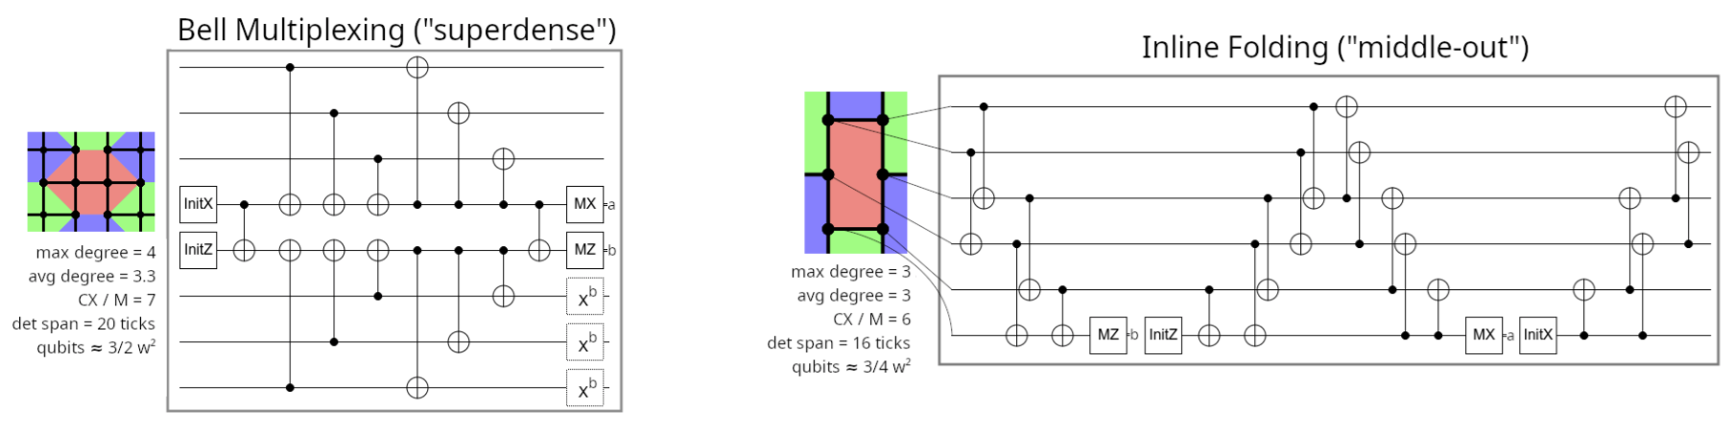
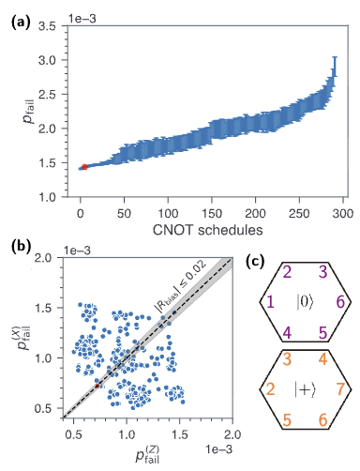
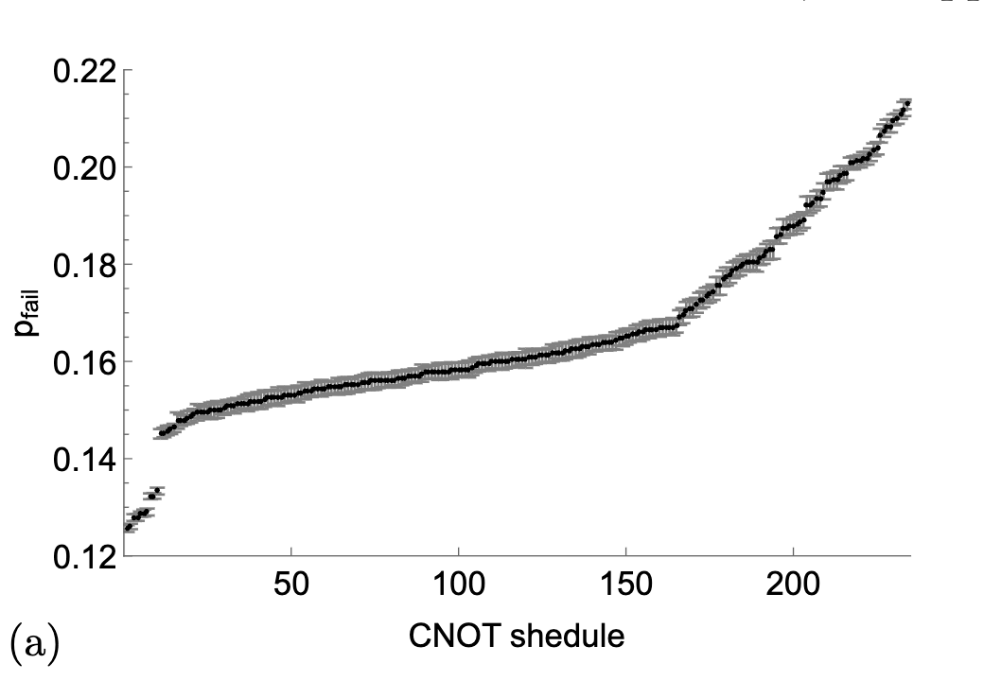
Color code
Previous work optimized over schedules which are uniform across all plaquettes.
https://arxiv.org/pdf/2510.00370 - read this!!
Craig Gidney and Cody Jones; arXiv:2310.16082
Michael E. Beverland, Aleksander Kubica, and Krysta M. Svore, PRX Quantum (2021); arXiv:2101.02211
Seok-Hyung Lee, Andrew Li, and Stephen D. Bartlett, Quantum (2025); arXiv:2404.07482

Slide 15
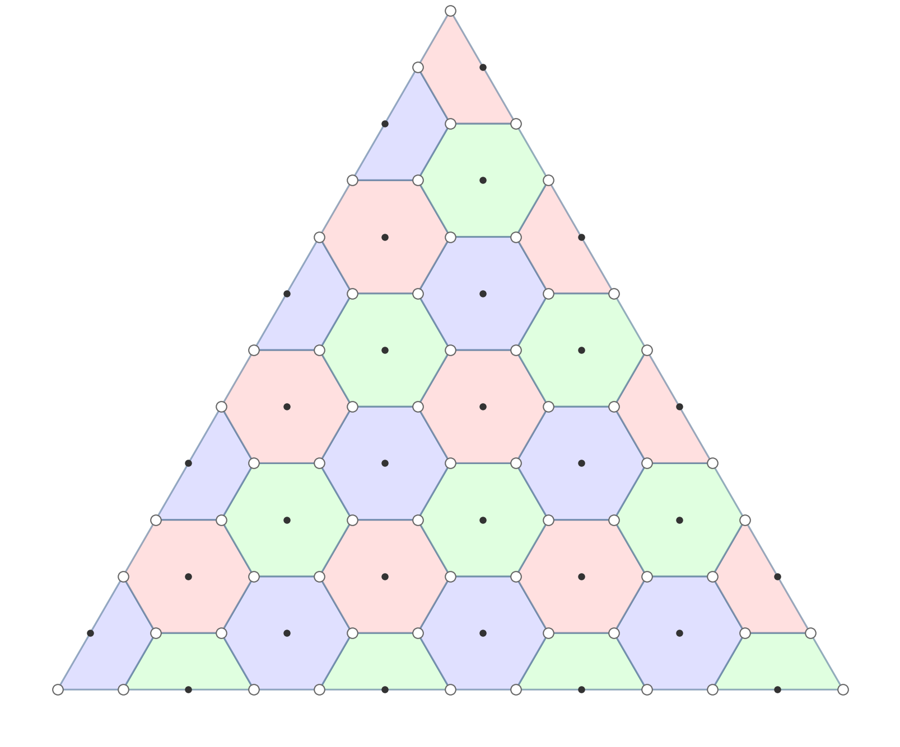






Hook error pairs to avoid

Slide 16
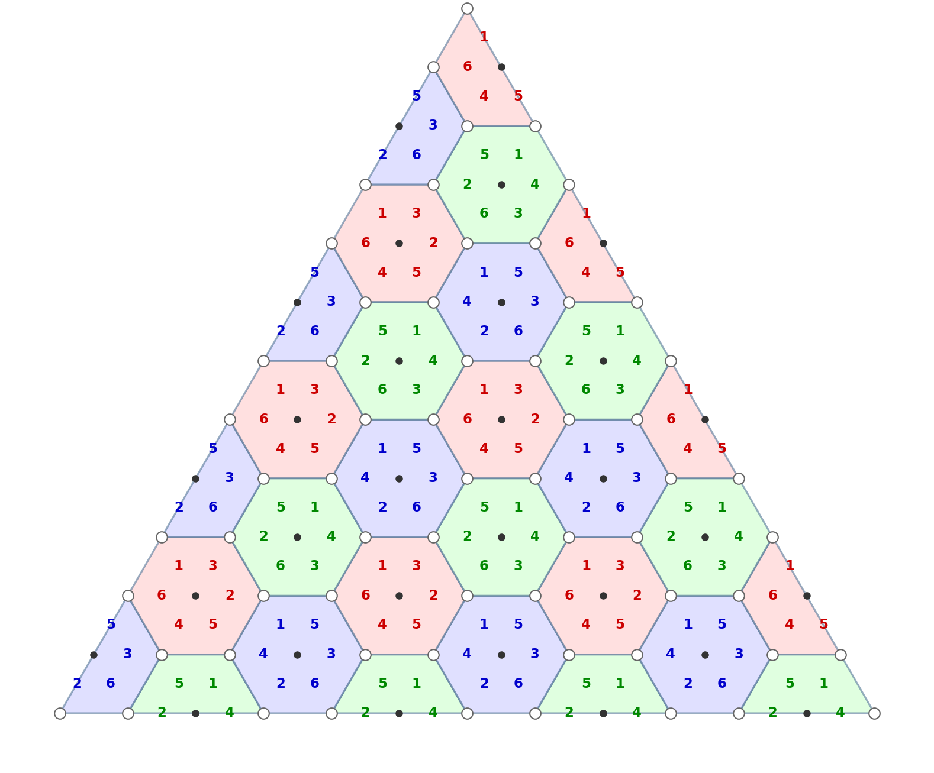
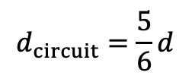

Different schedule for different colors
$$d_{circuit}=\frac{5}{6}d$$
But full distance in bulk!
Note: no single hook error is responsible ”fractional hook error”

Slide 17
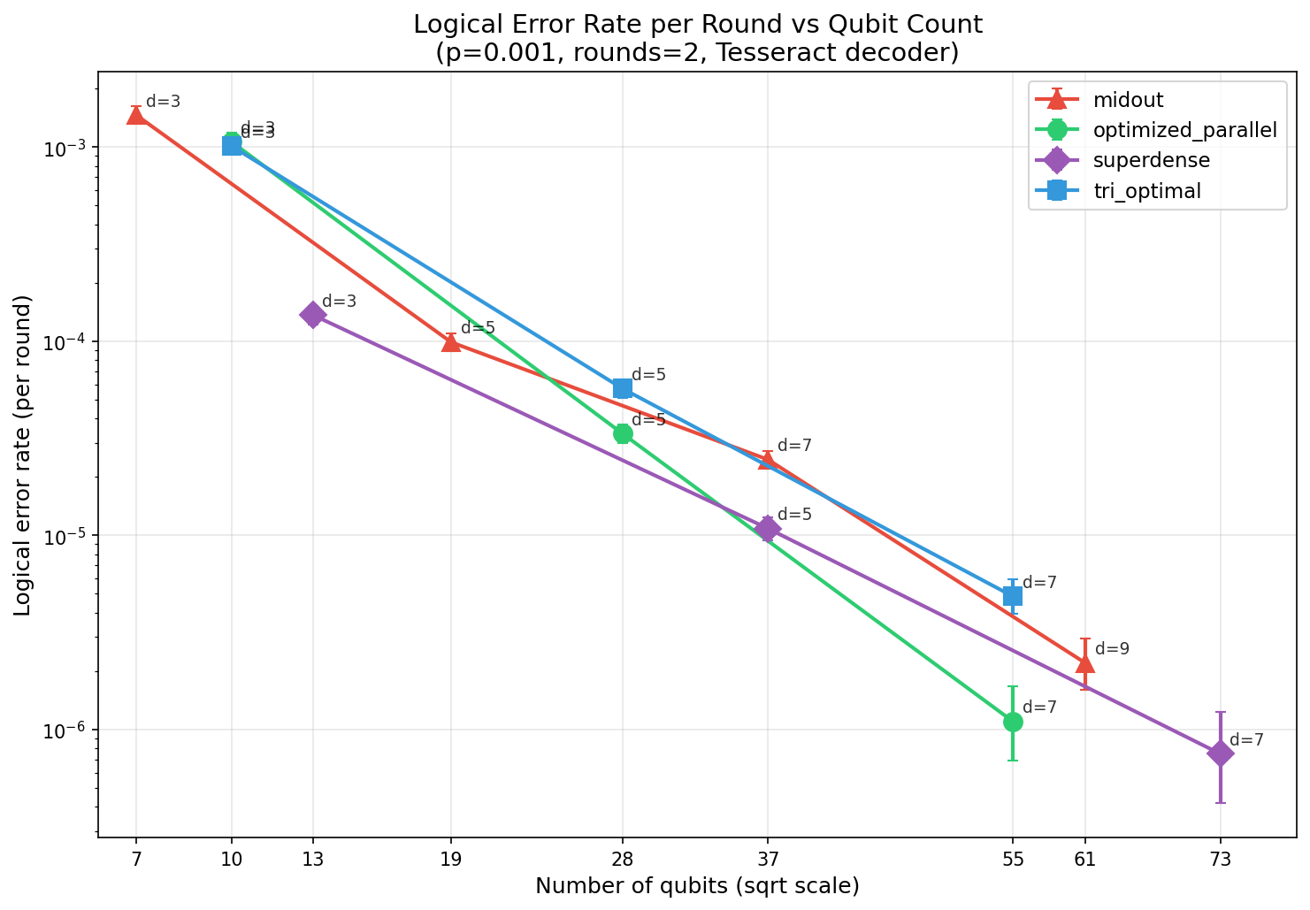
LER – 2 rounds, 0.001 error rate

Slide 18
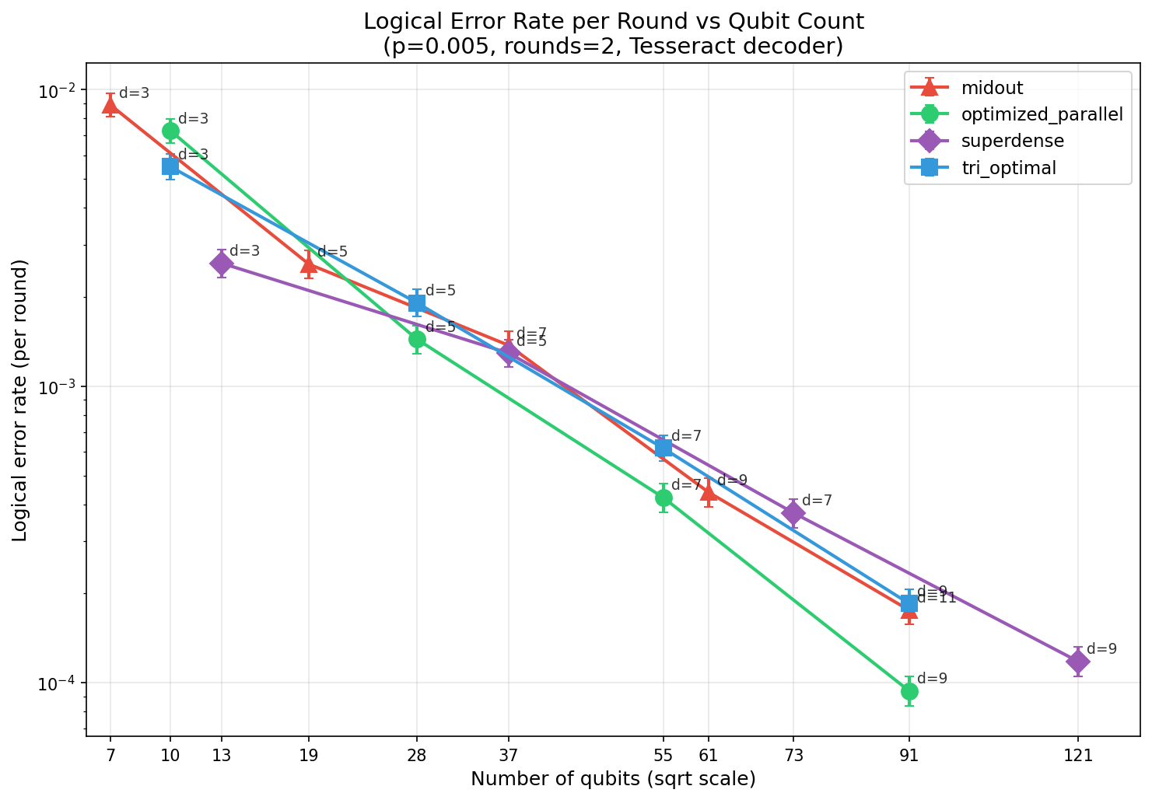
LER – 2 rounds, 0.005 error rate

Slide 19
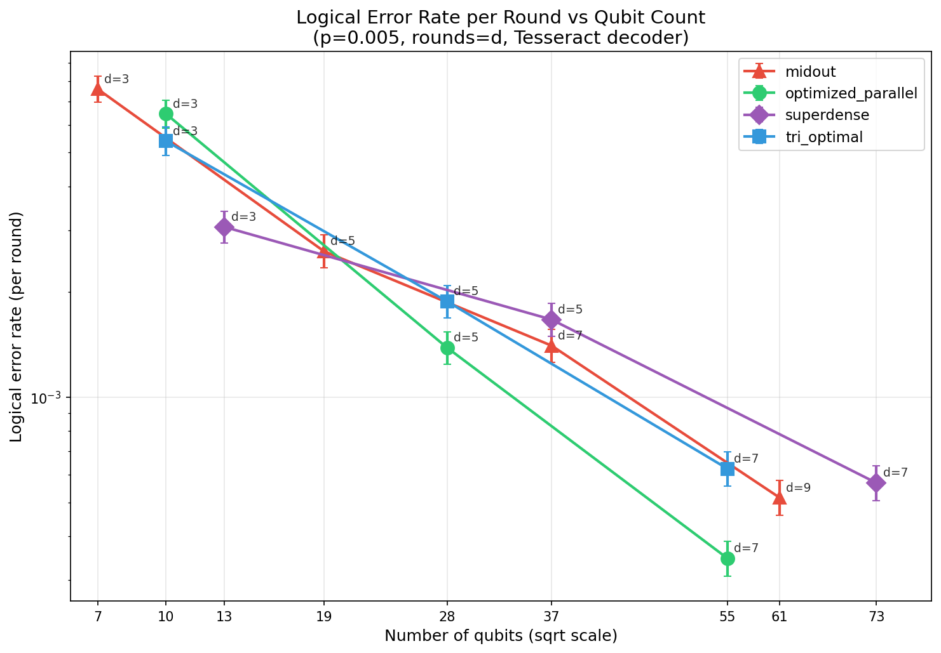
LER – d rounds, 0.005 error rate

Slide 20
Greedy algorithm for removing hook errors
Peform syndrome extraction one stabilizer at a time. Initialize to random order of interaction between auxilliary and data qubits.
Repeat until distance converges:
Find shortest logical error (or approximate).
Identify hook error components.
Choose one at random, and choose a new (random) schedule for the corresponding stabilizer.
Accept if new shortest error does not include a hook error at the same location, else reject.

Slide 21
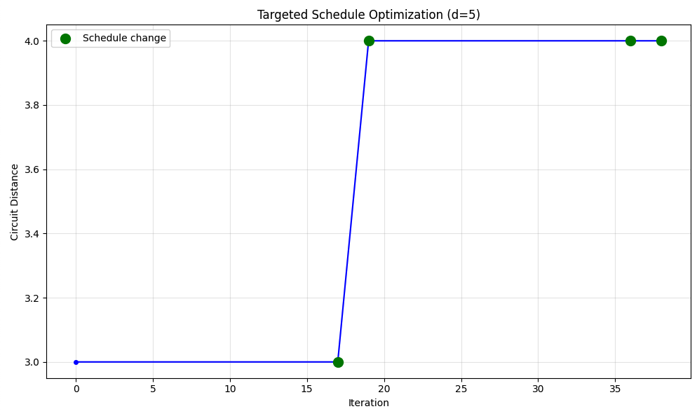
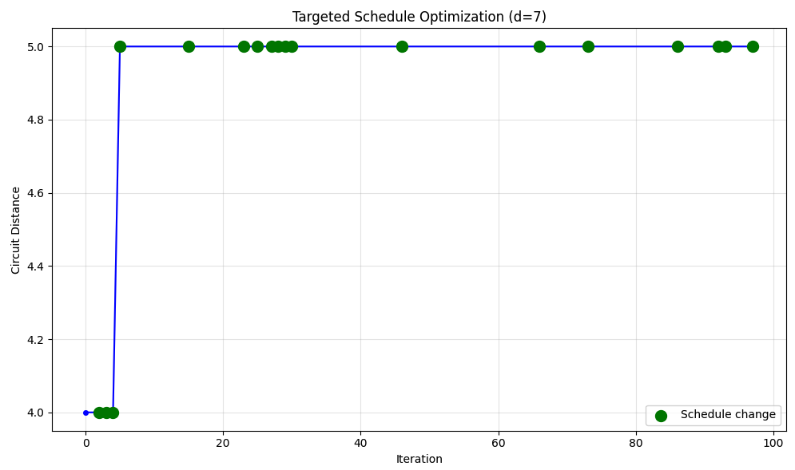
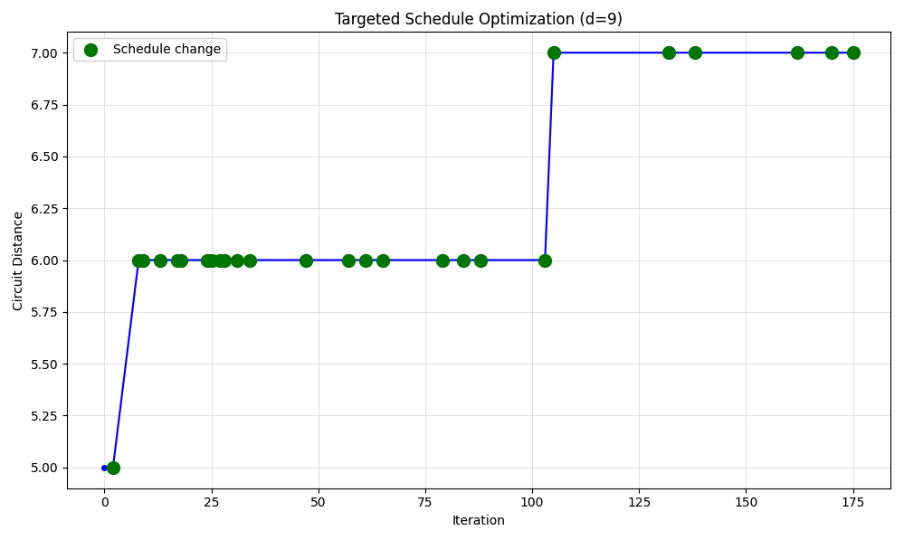
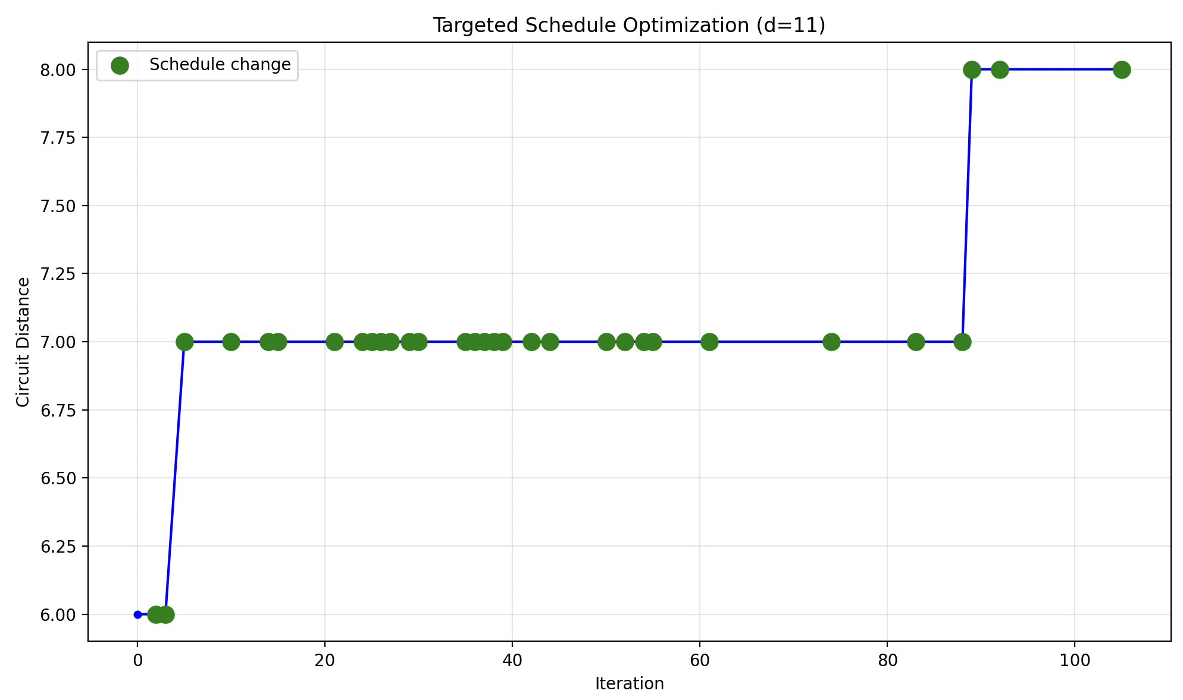
Greedy algorithm for removing hook errors
STUCK
STUCK

Slide 22
To Do
Benchmark memory experiment and junction for the new schedule and update slides.
Add detailed circuit for stretched stabilizer and crumble to slides for spatial Hadamard.
Benchmark spatial Hadamard logical error rate (compare vs. 2*memory experiement):
Decoders: matching, correlated matching, tesseract, bayesian flagging
Hadamard orientation: x,y
Flags: all, partial, none
k (d)
Physical error rate
Use cluster!
Better decoding with flags
For multiple flags triggered by same error – don’t include errors that trigger subset of flags.
Use correlated matching as subroutine.
Avoid strange clipping of probabilities.
Simulate also depth-4 (either zero idling noise or remove ticks).

Slide 23
Other situations to examine
Patch rotation
Yoking
Crosshairs boundaries
Other codes…
Color code
Cultivation circuit
Higher rate codes

Slide 24
Outstanding challenges
Creating stretched plaquettes is very manual
Automatic detector annotations aren’t minimal

